Slide 1


Slide 2
CONTENTS
SUMMARY | 3 | POWER STAKING | 37
THE PROBLEM | 5 | MARKETPLACE | 39
OUR SOLUTION | 13 | WHITELIST | 41
BENEFITS | 17 | THE 3-M’s | 43
DIGITAL ASSETS | 22 | ABOUT | 48
GENESIS OFFER | 29 | PROJECTIONS | 52
MOMENTUM SALES | 31 | RISK FACTORS | 55
UNIVERSAL SWAP | 35 | CONTACT INFORMATION | 106
8

Slide 3


8

Slide 4
OVERVIEW
EDGE196™ is a new-age enterprise designed to provide investors with access to innovative and cutting-edge startups through our revolutionary syndication economy. our goal is to democratize access to potential unicorns to all eligible investors.
The syndication economy, powered by digital assets and secured and managed on a distributed ledger (the Ethereum blockchain and others), provides direct and indirect investment access and transparency.
We are focused on creating near-term (1 year +) liquidity through potential redemptions and long-term return on investment through value accretion.
We believe EDGE196™ investors will benefit from enhanced liquidity, improved risk distribution, and access to startups that have prevailed through a 3-tiered fundamental due diligence conducted by global experts.
We believe Startups will benefit from EDGE196™’s 3-M’s - EDGE196™ provides a strategic investment source for Money, industry-leading Mentorship from EDGE196™ global experts, and Market Access by direct introductions to global vendors and potential clients.
EDGE196™'s mission is to transform the dysfunctional, insider's club of venture capital investing to allow and encourage all eligible investors to participate on a level playing field. We strive to be a catalyst to unite startups, investors, and service providers, by opening avenues to a marketplace in a borderless ecosystem, and maximising value through the EDGE196™ syndication economy.
8

Slide 5

8

Slide 6

The venture capital market has many inefficiencies that lock- out investors and restrict access to capital for startups.
Despite vast numbers of businesses launching every year, most startups still fail for a number of reasons including:
Insufficient capital, and/or poorly timed capital raising
Management distraction from product development to raise capital
Misunderstanding the capital markets
Lack of effective leadership mentoring
Poor product marketing and sales
Inability to access global markets and/or supply chains
VC’s position themselves as supporters, financiers, and even the instigators of innovation, yet the industry itself has been devoid of innovation for the past twenty years.
The cost of failure of startups is generally borne by angel investors, who rely on the success of a small number of targeted investments to recoup losses on failed investments.
Generally, investors spend an inordinate amount of time searching for, reviewing, and performing due diligence on a wide range of startups. With small capital, these investors must either be highly selective when making targeted investments with scarce dollars, or pay large fund fees to participate in diverse pools.
Sometimes, minimum investment requirements block smaller investors from opportunities which can cause them to miss out on lucrative opportunities.
8

Slide 7
THE CURRENT STATE OF THE STARTUP ECOSYSTEM
Starting a new business is a daunting undertaking rife with peril. Despite the odds-against, many ambitious entrepreneurs accept this challenge at some time in their lives. While there are no precise sources to track the number of new startups, research suggests that there are tens of millions of startups at some stage of business development at any given moment in time.
Most great ideas and the businesses that they drive, however, never come to successful fruition. An analysis of startups (specifically high growth tech ventures), shows that 92% of them fail within the first three years (some investment firms claim to have lower failure rates). We believe that EDGE196™'s 3-Ms can provide a measurable, positive increase to a startup's potential for success.
CHALLENGES FACING STARTUPS
There have been various research studies that have uncovered the reasons for the failure of startup companies. These studies cite several reasons, including lack of proper product-market fit, lack of productive team, and the inability to “master the message.” We believe that some entreprenuers lack general finance experience, some lack HR and other business management expertise, others can't gain access to necessary support services and customers. These challenges are interconnected, or sometimes precursors of the other.
For example, when a startup struggles after hiring the wrong people, it is more likely to run out of cash before its products gain market acceptance.
Another reason common failure is poor marketing and ineffective messaging. For instance, despite having a great idea, great product, a flawless sales platform can cause a startup to fail.
Most failures can be summed up by saying that the startup runs out of cash before its products reach customer acceptance.
8

Slide 8
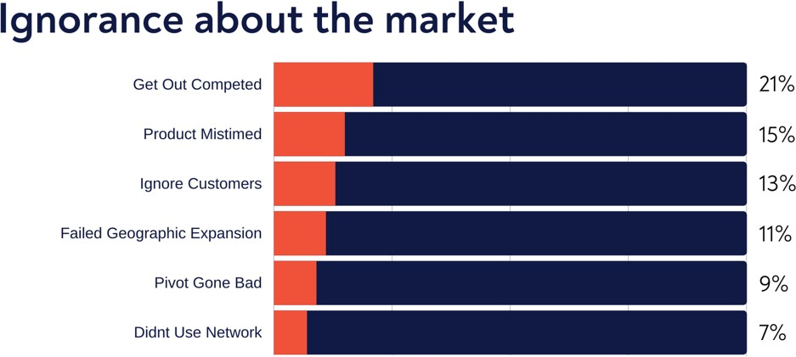
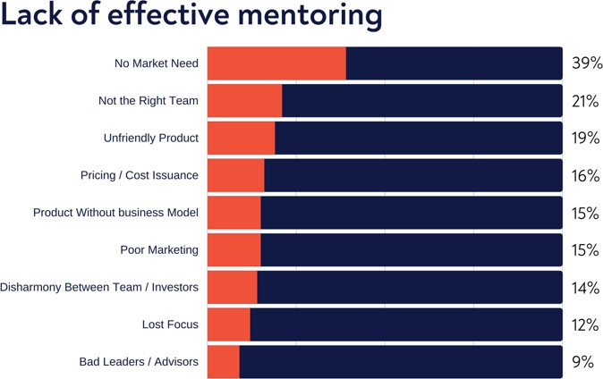
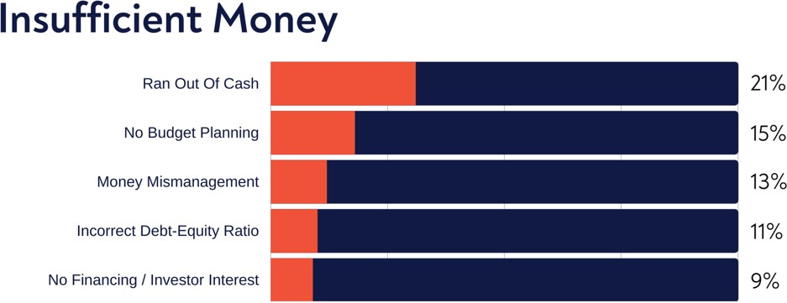
Many entrepreneurs invest their friends and family, to a greater or lesser extent, in the success of their projects. The failure of startups as a result of the challenges listed to the left not only impedes innovation and funding, it also hurts the friends and family who invest in the enterprise.
If an entrepreneur passes the friends and family round, the next set of investors are usually angels and venture capitalists. These angels and VCs usually use a "shot gun" approach by taking small stakes in many startups and try to overcome the overwhelming failure percentages by riding heavy on the backs of the few successes the pool.
Along the way, investors eager for success often become Impatient and apply counterproductive pressure on the startups. This pressure can cause startups to miss longer-dated opportunities.
The charts to the left show the main reasons why startups fail according to EDGE196TM proprietary research.
< Figure 1: CB Insights analysis of 1,098 tech companies
8

Slide 9
VENTURE CAPITAL MYTHS AND TRUTHS
Diane Mulcahy, in a Harvard Business Review titled "Six Myths about Venture Capitalists", debunked the myths concerning VCs. Following are her main points:
MYTH: VCs are often portrayed as risk-takers who back bold new ideas.
MYTH: VCs are believed to generate great returns on their investments.
TRUTH: While they do take risks, they risk their investors' capital and very little of their own.
TRUTH: Research suggests that the overall performance of the industry is poor.
In most VC funds, the sponsor's money often accounts for just 1% of the total. The industry's revenue model, long investment cycle, and lack of visible performance data make VCs less accountable for their performance than most other professional investors. What the VC risk is its reputation and track-record which if positive wins it more investor capital.
VC funds haven't significantly outperformed the public markets since the late 1990s, and particularly since 1997, due to less cash being returned to VC investors than what they have invested.
There is a small group of top-performing firms that generate great “venture rates of return” at least twice the capital invested, net of fees.
The reason behind that is the standard VC fund charges an annual fee of 2% on committed or invested capital over the life of the fund, which is usually 10 years.
However, it's hard to know definitively which firms are in that group because performance data are not generally available and are not consistently reported.
Moreover, the VC enjoys a significant percentage of the profits upon successful exit, usually when a portfolio company is acquired or goes public.
8

Slide 10
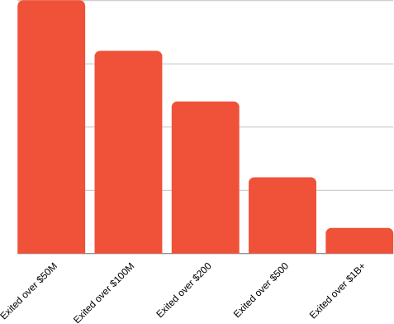
LACK OF VC INNOVATION
On average, most VC funds breaks even or loses money. VCs position themselves as supporters, financers, and even breeding ground of innovation, yet the industry itself has been devoid of innovation for the past twenty years.
Venture capital has seen plenty of changes over time - more capital input, bigger funds, and declining returns. But funds are structured, capital is raised, and partners are paid just as they were two decades ago.
Research by the Kauffman Foundation investment team dives deeper into the pain points of the Venture Capitalists globally. Their study analysed a twenty-year history of venture investing experience in nearly 100 VC funds with some of the most notable and exclusive partnership "brands". They concluded from the detailed study that the limited partner investment model is broken.
Limited Partners, including foundations, endowments, and state pension funds invest too much capital in underperforming venture capital funds on frequently misaligned terms.
^ Figure 2: CB Insights analysis of 1,098 tech companies

Slide 11
IS THERE ANY HOPE FOR STARTUPS?
The inflexibility of venture capital funding paints a bleak picture for the future of startups. While avoiding failure altogether is impossible, historical high levels of failure and the inability of investors to connect with the right enterprises reflect the presence of systemic flaws in the startup and investment structure.
Another sad reality regarding the challenges of a new startup is that most face these challenges alone. While startup services such as mentoring, investment, marketing, research, legal, etc. are currently available, connecting startups and these services are passive and fragmented at best.
Many initiatives and organizations such as universities, accelerators, venture capital companies, and others try to help promising innovators and their businesses. These disjointed services are often expensive, with very little reliable information available for startups to make informed decisions regarding which of these services will be a good use for their limited resources (management attention and money)!
Moreover, even though each of the above facilitators provide a piece of the solution, they are mostly disconnected from each other and fail to provide a holistic solution.
EDGE196™ provides that holistic solution that connects innovators, growth companies, qualified investors skilled service providers and potential customers.

Slide 12
BUT…MANY STARTUPS DO SUCCEED
In spite the strong headwinds, many startups are able to rise from the dust and soar high. The triumph of such startups is no surprise, given the combined effect of many success-inducing factors.
For instance, startups succeed when technology innovators are allowed to leverage successful business people through mechanisms of mentorship, advisory, and a repository of other services.
The Startup Genome report, initiated by Compass' E-commerce Genome, provides an in-depth analysis of data from more than 650 startups. One of the most evident results was that entrepreneurs who continued to learn were able to innovate and become more successful. Startups that had helpful mentors learned from other startups and leaders, and tracked metrics more effectively, raised 7x more money and had 3.5x better user growth.
Another important conclusion of the research was that many investors invested 2-3x more capital than necessary in startups that haven't reached their potential. They also overinvested in solo founders and founding teams without technical co-founders, despite indicators suggesting that these teams will have a much lower success rate.
This demonstrates that choosing the right investment opportunity is itself a challenging exercise. To maximize the chances of an investment to succeed, it will be wise to choose startups with the most potential for success and provide them with the best services and conditions to increase their chances of success.
We believe the EDGE196™ due diligence process identifies innovators with the greatest potential for success. As demonstrated here, if the right solutions are offered, the potential for long-term success is greatly increased.

Slide 13


Slide 14
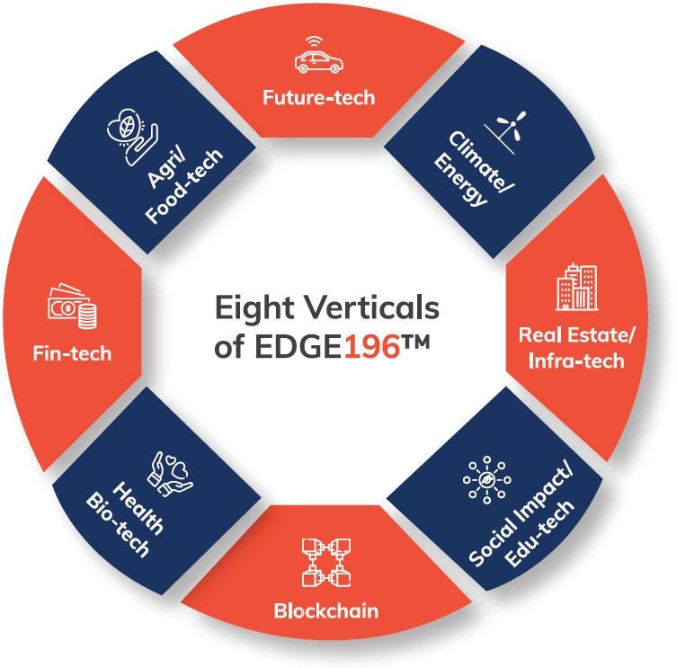
EDGE196™ has created a global ecosystem which connects startups with investment (Money), Mentoring and Market access, and simultaneously providing access for investors to participate on a level playing field in tech startup investments.
Two digital assets empower the entire ecosystem. Through EDGE-Q, EDGE196™ aims to provide venture capital investors with access to a pool of promising startups.
EDGE-X offers holders access to our revolutionary EDGE196™ Ecosystem.
EDGE-Q participates in success of our investments by fractional ownership. EDGE-X allows EDGE196™ participants to access to the EDGE196™ Ecosystem for discounted services provided by our innovative companies and partners.
Focused on creating short-term and long-term value for investors, our mission is to make investing in unicorns available to everyone. EDGE-Q holders grow with our companies. EDGE-X holders get
stable access to our services.
<
Our focus is predominantly on disruptive and innovative companies, including those involved in the following (not exhaustive) list of industries:

Slide 15

A level playing field for investors of all sizes to access investment opportunities in promising tech startups
EDGE-Q allows investors to participate in our pool of vetted tech companies alongside founders' dollars.
EDGE-X Is accepted by all of our investee companies and our support partners. Goods and services can be purchased at preferential rates using EDGE-X.
The EDGE196™ ecosystem utilizes digital assets, cryptographically secured on the Ethereum blockchain and others.
Purchasers can acquire EDGE-X directly from EDGE196™ via Genesis Sale and subsequent Momentum sales. EDGE-X is a liquidity bridge which serves as a transfer of value between holders and service providers.
Revenue raised from EDGE-Q sales is used to fund EDGE196™ investment in promising startups.
Startups apply to EDGE196™ for funding and undergo a rigorous 3-tier due diligence and vetting process. The winners will have access to EDGE196™ funding based on EDGE196™ approved business plans and budgets. Some of those that don’t make the first cut will have access to EDGE196™ global mentors to allow them to refine their offering and potentially win funding approval in subsequent rounds.
Accordingly, EDGE-Q investors will see their investment spread across numerous projects, space, and time. Thus, instead of risking millions of dollars on an individual concept, investors may spread their investment risk over a highly selective portfolio of opportunities.
Because EDGE196™ is a private firm, not a venture capital firm, it enables a much broader group of investors to participate in the kinds of unicorn level investment opportunities traditionally accessible only to deep-pocketed venture capital firms and
financial institutions.
15

Slide 16
EDGE196™ aims to place alongside major disruptors
EDGE196™ aims to disrupt the venture capital industry by creating an ecosystem of security, stability, and enhanced benefits for startups seeking funding, investors looking for suitable investments, and service providers willing to work with a highly-motivated and passionate group of entrepreneurs.
We envision a time when industry participants will regard EDGE196™ as the standard benchmark. No longer will investors accept opaque, centralized fund management, and disproportionately high cost and risk, for low to moderate returns.
Transforming venture capital…
16

Slide 17


Slide 18
Entrepreneurs benefit from EDGE196™'s network of global mentors, the EDGE196™ ecosystem of vetted service providers, and a single source of investment funding.
STARTUP ECOSYSTEM
EDGE196™ strives to create an innovator's ecosystem of capital, mentorship, and business support, by providing a platform to help startups achieve their fullest potential and leave a lasting impact on the world by improving the lives of the people they touch.
Through its ecosystem, EDGE196™ is building a supportive, all-inclusive economy that intelligently connects innovators, investors, and service providers.
Our goal is to fund 10,000 innovators over the next five years and use the EDGE196™ ‘3M Model’ (Money, Mentorship, and Market Access) to drive our portfolio companies to success.
PARTNER NETWORK
An inclusive innovation system must have a global reach. A worldwide team of investors, technology consultants, and business leaders has been built, and has curated and engaged 100+ contributors and partner services spanning hundreds of cities and more than 70 countries.

Slide 19

EDGE196™ has a number of distinct advantages over traditional VC firms.
EDGE196™ digital assets are built on multiple blockchains, creating a trustless system which encourages participation by investors, reduces costs and provides a level of security and accountability unique in the VC world.
LOW-COST STRUCTURE
Public blockchain networks, such as Ethereum, are sustained by independent servers, which ensures transaction costs are marginal compared to traditional finance sector models.
INCREASED SECURITY
Cryptographic security is built into the foundation of blockchain technology.
ENHANCED AUTOMATION
Sophisticated smart contracts automate processes and reduce human error in transactions.
REGULATORY COMPLIANCE
Blockchains are immutable, public and permanent, thus support auditability. EDGE196™ platform also includes strong ‘Know Your Customer’ KYC procedures.
EDGE196 brings innovative and transformative solutions to its portfolio companies such as Blockchain technology, global innovation and the fostering of strong mentorships and advisory relationships.

Slide 20
Our USP’s
Unique blockchain enabled ecosystem
Access to global investment opportunities seeking unicorns
Smart contract enabled transactions
Investor voting on portfolio selection
Mitigating risk via pooled investment
Early detection of failure
Enhanced Liquidity
Faster global expansion
Proposed listing of EDGE-Q on ATS
Digital asset swapping
Higher success rates for startups
Higher IRR

Slide 21


















How do traditional VC firms compare with EDGE196TM?
PORTFOLIO
TRANSPARENCY
DECISION MAKING
EDGE196™ invest in multiple startups assuming many will reach various levels of success and exits.
EDGE196™ uses blockchain secured transparent accounting and decision- making system.
EDGE196™ utilizes a 3-tier due-diligence procedure involving a global team and crowd intelligence system.
TEAM LOCATION
FOCUS OF ATTENTION
RETURNS
EDGE196™ has a global team and network of mentors and advisors.
EDGE196™ serves the global startup community around the world.
EDGE196™ focuses on targeted higher returns with multiple exit strategies.
DIVERSIFICATION
LIQUIDITY
SERVICES
EDGE196™ investors have the privilege of being able to diversify their portfolio.
EDGE196™ investors can expect greater liquidity through the ability to sell or stake EDGE-X tokens.
EDGE196™’s marketplace connects startups, investors and service providers.

Slide 22


Slide 23





EDGE-Q
EDGE-X
EDGE-X is a digital asset, structured as a ‘bridge’ to transfer value between EDGE196™ participants on the Ethereum network, other blockchains and secondary markets.
EDGE-Q is a digital asset which tracks the performance of EDGE196™'s investment portfolio and will gain value based on the portfolio's valuation.
Essentially, EDGE-Q represents equity in the EDGE196™ company.
EDGE-X can be used within the EDGE196™ Ecosystem to render services, and to enable the EDGE196™ global ecosystem.
BUY AND SELL EDGE-Q VIA
BUY AND SELL EDGE-X VIA
Daily Pool
Universal Swap
Daily Pool
Universal Swap
Investors can purchase EDGE-X on the edge196.com website. Investors purchasing EDGE196™ digital assets are required to undergo KYC/AML review, and fulfil applicable regulatory requirements. Once completed, users wallets will be whitelisted.
Investors wishing to purchase EDGE-Q have a vesting period of more than 1 year.

Slide 24
EDGE-X DIGITAL ASSET
THE EDGE-X BRIDGE
EDGE-X is a digital payment token that acts as a liquidity bridge to transfer value between assets on the Ethereum network, other blockchains, and secondary markets. Investors can convert digital assets to EDGE-X and vice versa.
By acting as a bridge, EDGE-X provides enhanced liquidity in the ecosystem. EDGE-X can also be used within the EDGE196™ Global Marketplace and for accessing services from ecosystem mentors.
EDGE-X VALUE
EDGE-X will open for purchase via the Genesis Offer with a fixed base price. EDGE-X purchased in the Genesis Offer will be subject to a holding period of 366 days.
REGULATION
EDGE-X holders, whether direct purchasers EDGE196™ or recipients from a holder, must pass KYC and AML review prior to release of trading restrictions.

Slide 25


GENESIS OFFER
The EDGE-X Genesis Offer will begin prior to listing on exchanges, with 500 Million (500,000,000) EDGE-X tokens available to early investors and crypto enthusiasts at a fixed price of $0.10 per EDGE-X. Genesis Offer EDGE-X will vest on a schedule of between 1 – 4 years.
Purchasing and Selling EDGE-X
Maintaining liquidity and ensuring long term viability of value of the digital assets through successful partnerships and investment is the primary focus of EDGE196™.
MOMENTUM SALES
EDGE196™ may periodically conduct momentum sales to allow investors to purchase additional EDGE-X tokens. A momentum sale is a measured and controlled release, and bonuses may be awarded for participation and willingness to accept lock-up periods. EDGE-X will be traded on exchanges and the market will determine the price. The company reserves the right to suspend sales at any time.
To that end, EDGE196™ has made it possible to purchase and redeem our class of digital assets through a variety of means.
Multiple price oracles may be used to determine the base price of EDGE-X.
UNIVERSAL SWAP
Investors may be able to swap EDGE-X using the decentralized Universal Swap feature.
SECONDARY EXCHANGES
Investors may purchase EDGE-X from secondary exchanges or by direct trade for services or other liquid assets such as cash, Bitcoin or Ethereum.

Slide 26
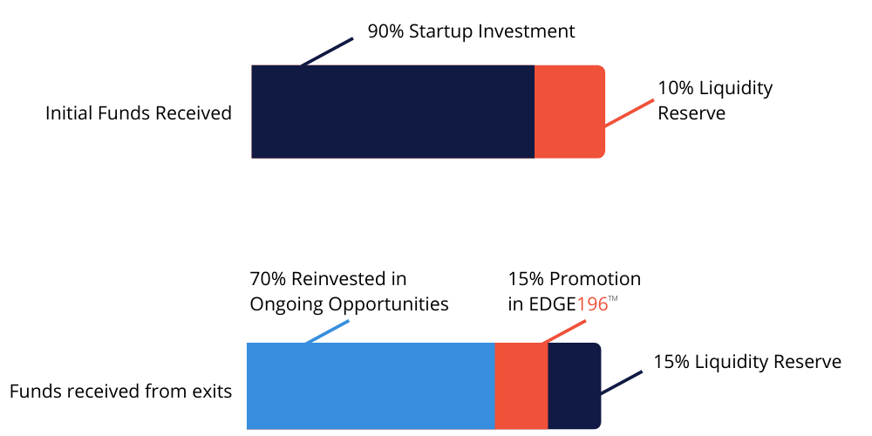
RAISING INVESTMENT CAPITAL
Funds raised from the sale of EDGE-Q are used to fund approved startups, and drive the global ecosystem.
USE OF FUNDS
Funds received from digital asset sales will be used to drive a robust and thriving ecosystem to benefit EDGE196™ investors by infusing 100% of the capital in startups and the Liquidity Reserve.
From the funds received from exits, 70% will be reinvested in new or existing VC opportunities, 15% will be allocated to the Liquidity Reserve, and a further 15% will be used for the promotion of EDGE196™.
^ Figure 3 Use of funds

Slide 27
LIQUIDITY RESERVE
10% of funds raised from the sale of EDGE-X will be held in a segregated account known as the EDGE196™ Liquidity Reserve to support long-term price stability and value growth for the EDGE196™ startup ecosystem.
The Liquidity Reserve will serve three purposes:
The Liquidity Reserve will be used to ensure the stability of the EDGE196™ startup ecosystem by boosting the liquidity of EDGE-X and reducing extreme price volatility. EDGE196™ will, as necessary, use funds in the Liquidity Reserve to strategically buy-back EDGE-X to lay the foundation for consistent and stable growth of the Digital Assets with the EDGE196™ startup ecosystem.
At the discretion of EDGE196™, funds from the Liquidity Reserve can be used to redeem EDGE-X from service providers should they need to liquidate their holdings.
The Liquidity Reserve will provide a safety net via cash reserves to bolster the value of EDGE196™ and support operations.

Slide 28
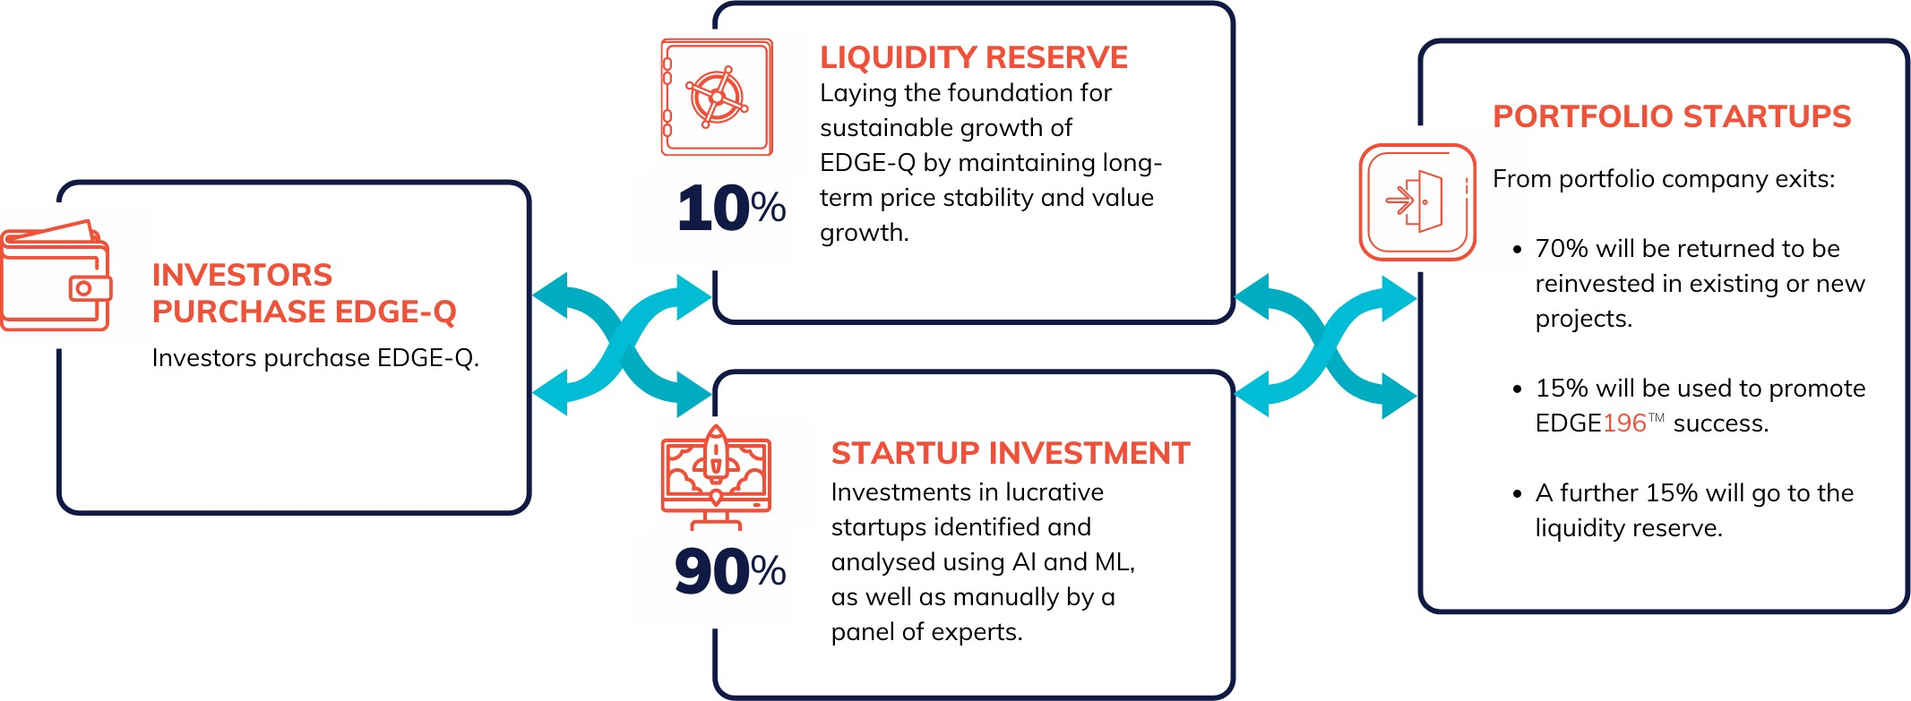
EDGE-Q & The Liquidity Reserve
^ Figure 4: Liquidity
The liquidity fund is designed to keep the price stable and reassure a guarantee of stability.

Slide 29


Slide 30
OVERVIEW OF GENESIS OFFER
The EDGE-X Genesis Offer will begin prior to listing on exchanges, with 500 million (500,000,000) EDGE-X tokens available to early investors and crypto enthusiasts at a predetermined price.
Users can participate in the Genesis Offer via the EDGE196™ website (https://edge196.com) and must register on the portal and undergo mandatory KYC/AML to be eligible. Upon successful registration and compliance checks, investors will be able to buy any amount of EDGE-X token until the Genesis Offer has been exhausted.
CONTRIBUTION MECHANISMS
EDGE-X digital asset can be purchased via:
Direct ETH contribution – Users can
contribute ETH directly to the contract
address and get EDGE-X sent to their wallets.
Crypto payments – Utilize your BTC, LTC and other major cryptos to directly buy EDGE-X.
Direct payments via all major cryptos are supported.
Fiat gateways – Fiat payments are enabled through integrations with major fiat to
crypto gateways. Users can buy EDGE-X via card/bank payments in USD, EUR and other major fiat currencies.
LOCKUP PERIOD
All EDGE-X purchased in the Genesis Offer will be locked up for a period of 366 days.
CONDITIONAL GENESIS OFFER CLOSURE
The Genesis Offer will run until all allocated EDGE-X has been purchased, however the minimum
subscription is set to 25% of the total (in other words 125,000,000 EDGE-X must be sold before EDGE196™ will release any EDGE-X.
In the event of less demand for the Genesis Offer, EDGE196™ may discontinue the sale upon 25%
sales, and allocate the remaining EDGE-X to future Momentum Sales.

Slide 31


Slide 32
OVERVIEW OF MOMENTUM SALES
EDGE-X is circulated via a simplified pool structure (Momentum Sales with bonus incentives) where the purchasers / users can purchase EDGE-X through multiple crypto and fiat options.
EDGE196™ intends to run daily Momentum Sales year-round and plans to sell a total of 7.9 billion EDGE-X digital assets in incremental volumes. Each Momentum Sale will have a pre-defined number of EDGE-X that will be available through sale pools that will run till the pre-defined volumes are exhausted, or the maximum time limit is reached.
Depending on the level of sales, bonuses are allocated to the participating users (refer to bonus section)
MOMENTUM SALE PARTICIPATION
Momentum Sales run on:
EDGE196™ website.
Exchanges - as primary offering.
By investment bankers, broker-dealers, funds around the world.
In order to participate in the Momentum Sale, users register on the edge196.com portal and go through mandatory KYC/AML. The Momentum Sale is also integrated into crypto exchanges as primary offerings. Exchanges will have pre- allocated EDGE-X volumes, thereby allowing registered users (from the exchange side) to participate seamlessly in Momentum Sale.

Slide 33
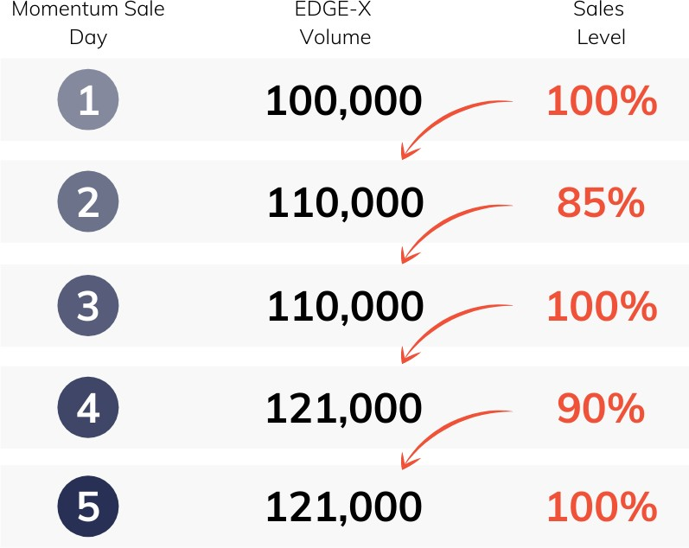
MOMENTUM SALES VOLUMES
Momentum Sale volumes are set based on the level of buying on the previous day’s Momentum Sale as per the following conditions:
If the previous days Momentum Sale is 100% sold out, the next days’ EDGE-X volume is increased up
to 10% of the previous days’ volume
If the previous days Momentum Sale is not sold out, the next days’ EDGE-X volume will be the same as
the previous day.
EDGE196™ will adjust the volume based on historic Momentum Sale data to ensure nominal demand is maintained. The first Momentum Sale’s volume is set to 5,000 EDGE-X.
Figure 5: How Momentum Sales volume is calculated ^

Slide 34
PRICING MECHANISM
On the first day of the Momentum Sale, the EDGE-X price will be set to $0.10 per EDGE-X.
MAXIMUM TIME WINDOW
Upon reaching the sale cut-off, the Momentum Sale is stopped, and the corresponding settlement will be initiated. The settlement window will start after the completion of the Momentum Sale and will be used to allocate EDGE-X to investors and determine the volume for the next Momentum Sale.
Until the secondary market is established, the EDGE-X price will be determined by EDGE196™ with nominal set increases.
Once the secondary market is established, the EDGE-X price will be based on the secondary market value.
Under exceptional circumstances, the EDGE196™ administrator will be able to suspend the Momentum Sale for a small period of time.
A price oracle Is integrated into the platform to continuously feed in average secondary market pricing from the exchanges.
After the expiry of this period, the ongoing Momentum Sale will resume automatically.
SETTLEMENT & DISTRIBUTION PROCESS
At the end of each Momentum Sale there is a small window of time that will be utilized for settlement. The settlement process entails distributing of the EDGE-X in the investor’s digital wallets, as per the allocation.

Slide 35


Slide 36
UNIVERSAL SWAP
EDGE196™ has implemented a Universal Swap system which provides investors with a decentralized digital asset-swap option for EDGE-X and other digital assets.
Universal Swap enables an Investor to make immediate swaps between a number of supported digital assets.
These trades are only for whitelisted wallet holders that have been approved by EDGE196™ for KYC and AML regulatory requirements and subject to other regulations on a country-by-country basis. Should a receiving wallet not be on the whitelist, the transaction will fail to complete.

Slide 37


Slide 38
POWER STAKING OVERVIEW
EDGE-X holders can choose to take advantage of the Power Staking feature, which allows any amount of their EDGE-X to be staked, and in return benefit from staking rewards, which generate an ROI in the form of more EDGE-X digital assets. This is akin to a savings account that realizes interest.
POWER STAKING GUIDELINES
EDGE-X holders can choose to stake any amount of their EDGE-X using our Power Staking feature, and in return benefit from staking rewards, which generate an ROI in the form of more EDGE-X digital assets.

Slide 39


Slide 40
GLOBAL MARKETPLACE
The EDGE196™ global marketplace will strive to connect startups and pre-vetted, qualified service providers.
Our goal is to provide startups with a direct channel of communication with the EDGE196™ team, along with other services crucial for their growth in a global marketplace.
Our marketplace will fully engage startups, investors, and qualified service providers. It will be a one-stop solution that seeks to provide an answer to all their needs.
Startups will enjoy special discounted service rates that are specific to participants in our ecosystem.
Investors and Service Providers who are part of our ecosystem can also use the marketplace and enjoy the same access and special discounted rates as the startups.

Slide 41


Slide 42
WHITELIST OVERVIEW
A whitelist is implemented to allow EDGE196™’s smart contracts to interact only with approved addresses. This means only whitelisted addresses can receive and/or transact using EDGE-X once they have undergone suitable KYC/AML checks:
EDGE196™ maintains one whitelist for each EDGE196™ digital asset and a whitelist processor updates the whitelist.
The EDGE196™ admin can block wallets that no longer meet AML/KYC or other terms of use from receiving new digital assets.
If investors purchase EDGE196™’s digital assets from third-party exchanges, the investors' wallet address is automatically added to the whitelist once approved by the third-party exchange.
Investors from regulated countries will need to pass a full accreditation check.
During EDGE196™’s Momentum sale, every investor is whitelisted based on their KYC/AML which is checked through third-party providers and updated within the EDGE196™ system.
The EDGE196™ system will periodically check the whitelist with KYC/AML providers against the existing investors and update accordingly.

Slide 43



Slide 44



Our ‘3M Solution’
MONEY
We receive investment funding through our sophisticated investor network, which allows portfolio companies to receive funding from a single source.
The EDGE196™ methodology offers more than just funding to successful startups. It is an entire ecosystem dedicated to helping them achieve success, with mentoring, advice and global market access.
EDGE196™ adds tremendous value to startups via the global experts who make up the EDGE196™ community.
MENTORSHIP
We provide access to our preselected network of mentors with expertise in law, finance, technology, research, marketing, training, leadership, process, compliance, and quality systems.
MARKET ACCESS
We provide assistance with a ready-made marketplace where deals get approved, products and solutions are validated, partnerships are forged, and results are delivered.

Slide 45



TIER 1
Nomination by EDGE196™ partners and other stakeholders who propose companies which are sufficiently mature, financially viable and have passed basic product performance tests.
3-tiered investment review process
The EDGE196™ investment review process qualifies startups and determines the level of investment.
TIER 2
EDGE196™’s global team of industry experts perform a detailed evaluation, producing a recommendation based on the startups idea, business model, team and due-diligence.
TIER 3
EDGE-Q holders vote on proposals to fund prospective startups. They may also vote to extend funding to an existing portfolio company which has achieved certain milestones.
This decentralized process consists of three tiers of review which combines in depth technical and fundamentals reviews by highly experienced industry professionals, backed up with AI and Machine Learning algorithms, and finally the wisdom of the investors.

Slide 46
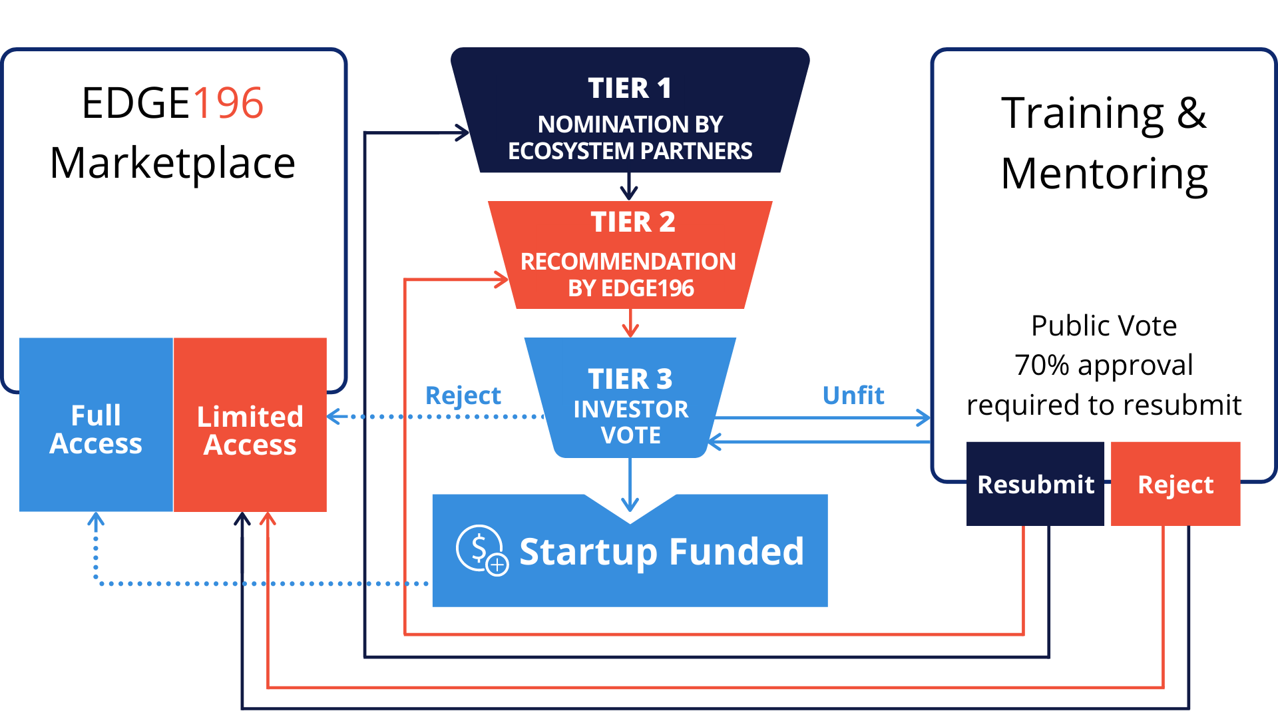
The Vetting Process
The investment process is fully decentralized, controlled by the community of EDGE-Q token holders. Reasonably high- bar standard startups are first identified by community partners and stakeholders, then an internal team of experts issues a recommendation, and finally the EDGE-Q token holders vote on which startups merit funding, and which do not. Voting is proportional to the size of the amount of EDGE-Q each investor holds.
If rejected, some will be offered a program of training and mentoring, and then undergo a vote by EDGE-Q. If they receive 70% or more approval in this vote, they re-enter at the last tier they reached.
If they do not receive 70% approval, they are rejected as a potential portfolio company, but still receive limited access to the marketplace.
Once a startup company has successfully completed all 3 tiers, and received a successful vote of approval by investors, they receive access to funding subject to approval of their business plan and budge, full access to the marketplace, as well as world-class growth mentoring.

Slide 47






EDGE196™ launched Global Startup Competitions to identify startups exhibiting the most promise during our own startup and pre-
Startup competitions and hackathons
Startup competitions, pitch-events and hackathons are one of the ways we identify startups with serious growth potential.
To date, EDGE196™ has run two competitions, with a third Global Startup Challenge launched in Q4 of 2020.
ecosystem days.
Our first startup competition launched in April 2017, focused on the India region, and 1100+ startups applied, with 7 reaching the grand final.
Our Upcoming Hackathons
Sugar Land USA Deep Tech Hackathon
Our second startup competition launched in September 2017 and focused on the Fintech sector. Startups from more than 70 countries applied, of which 14 reached the grand final.
Q3 2021
Geneva Global Climate Hackathon
Q4 2021
Nairobi Global Food and Water
Q1 2022
Ongoing initiatives and hackathons are now a major part of our strategy to discover and assess promising startups for investment, and our ‘3-Ms’ process is a major part of how we enable these promising startups to succeed.
Rio De Janeiro Global Hackathon
Q2 2022
Sydney Sustainable Cities Hackathon
Q3 2022
New York Hackathon
Q4 2022

Slide 48


Slide 49
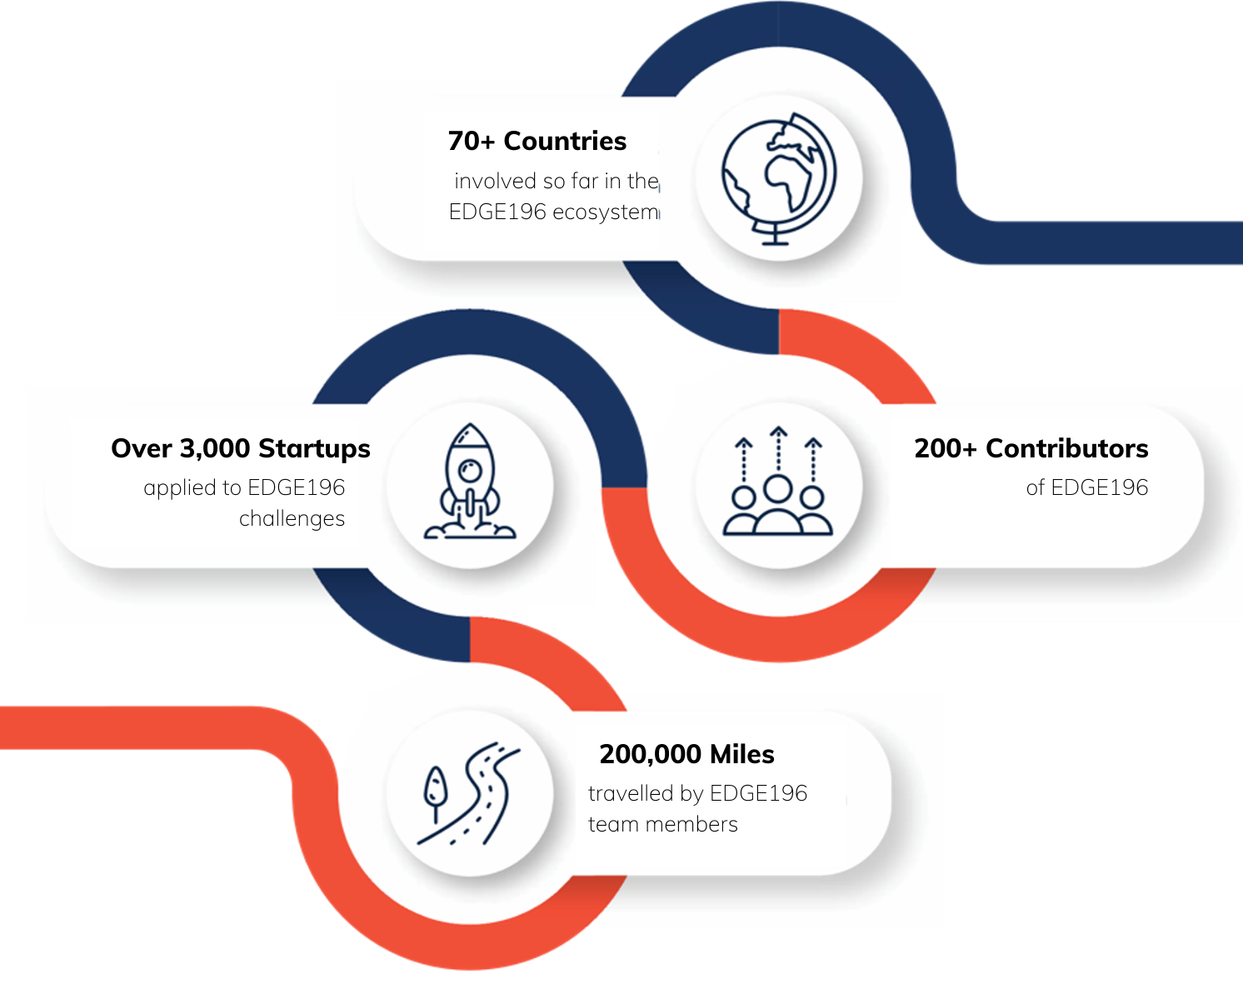
Our Journey
EDGE196™ was founded in 2018 by serial innovator, entrepreneur, and investor Dr. Jay Patel.
He began by searching for outstanding champions, forming cross-functional teams, bringing in mentors and qualified investments that opened new channels of marketing and consulting.

Slide 50

2016
EDGE196 Conceptualized, with a world tour to build ecosystem partners.
Launch of NRI Startups India.
Timeline
2017 | 2018 | 2019
EDGE196 technology team built. Alpha version of EDGE196 launched providing startup | Organised global startup challenge. Concluded with 100 participants. Invested in Chitmonks. | Invested in UBI Shares.
Alpha version of EDGE196 mobile app for Android and iOS developed. News sources from various | Fintech Grand Finale organized in New Delhi, with 20 finalists. Invested in Jointer. | Expanded EDGE196 ecosystem in Asia.
Core investment sectors defined. EDGE 196 Global Startup challenge 2017: Fintech | Expanded EDGE196 ecosystem in Europe. Launched Blockchain196 | Launched Generation Heights.
Android and iOS mobile apps launched successfully in 40 countries. Invested in DHI Labs and | Invested in Funding Tree. Invested in Hackmania. | Invested in TMQR.
Q1
Q2
Q3 Q4

Slide 51

2020 | 2021 | 2022
Launched NRISI. Invested in Tazwiz. Invested in Mobiepay. | EDGE-X development, auditing and testing. Wallet integration. EDGE-X multichain | Forging partnerships with banks and financial institutions. Acquire broker-dealer license.
Started development of TECH196 Invested in Iuzeit. | Full Launch of EDGE-X for non-US investors. Launch REMP196. | Launching in-house projects empowering the EDGE196 ecosystem.
Defined the EDGE196 Enterprise Architecture. EDGE-X Token designed and built. | Launch Yoga Nations v1.0 Launch of TECH196. Launch Marketplace 1.0 Add support for more ATS. | Future tech projects. Establish a digital bank.
Asia Blockchain and Fintech Startup competition concludes with over 100 applications from 20 countries. Added over 30 ecosystem partners. | Launch Marketplace v2.0 Integrate EquityUp into marketplace. Launch Yoga Nations v2.0. | Global Grand Investment Summit.
Q1
Q2
Q3 Q4

Slide 52


Slide 53
Investment Projections
Year | Startup stage | No. | of startups | Ave. investment | Total investment | Total | new startups
 | Seed | 40 |  | $25,000 | $1,000,000
2021 | Series A | 6 |  | $200,000 | $1,200,000 | 50
 | Series B/C/D | 4 |  | $1,000,000 | $4,000,000
 | Seed | 760 |  | $25,000 | $19,000,000
2022 | Series A | 140 |  | $200,000 | $28,000,000 | 950
 | Series B/C/D | 50 |  | $1,000,000 | $50,000,000
 | Seed | 1600 |  | $25,000 | $40,000,000
2023 | Series A | 300 |  | $200,000 | $60,000,000 | 2000
 | Series B/C/D | 100 |  | $1,000,000 | $100,000,000
 | Seed | 2400 |  | $25,000 | $60,000,000
2024 | Series A | 450 |  | $200,000 | $90,000,000 | 3000
 | Series B/C/D | 150 |  | $1,000,000 | $150,000,000
 | Seed | 3200 |  | $25,000 | $80,000,000
2025 | Series A | 600 |  | $200,000 | $120,000,000 | 4000
 | Series B/C/D | 200 |  | $1,000,000 | $200,000,000
THE PROJECTIONS ON THIS PAGE ARE ESTIMATED PERFORMANCE GOALS ONLY, ARE HYPOTHETICAL, ARE NOT BASED ON ACTUAL RESULTS AND ARE NOT GUARANTEES OF FUTURE RESULTS. THESE PREDICTIONS DO NOT REPRESENT OR GUARANTEE THAT ANY GOALS WILL BE MET, AND NO REPRESENTATION IS MADE THAT EDGE196TM WILL, OR IS LIKELY TO, ACHIEVE THESE GOALS.

Slide 54
DISCLAIMER
THIS IS NOT AN OFFER TO PURCHASE OR SELL SECURITIES
This document is for informational purposes and is not an offer to sell or a solicitation of an offer to buy any securities in EDGE196™ (the “Company”) and may not be relied upon in connection with the purchase or sale of any security. Certain disclosures, disclaimers and risks related to the Company, its operations, EDGE-Q and EDGE-X can be found at https://edge196.com (our “Disclosures”). Be sure to read these Disclosures thoroughly and review the merits and risks of an investment in EDGE196™ with your legal, tax and financial advisers before investing in EDGE196™. For US Investors’ interests in the Company, if offered, will only be available to parties who are ”accredited investors” (as defined in Rule 501 promulgated pursuant to the Securities Act of 1933, as amended) and who are interested in investing in the Company on their own behalf. Any offering or solicitation will only be made to qualified prospective investors pursuant to confidential subscription documents and our Disclosures, all of which should be read in their entirety.
FORWARD LOOKING STATEMENTS
This Confidential Information Memorandum contains “forward-looking statements.” These forward-looking statements are based on the Company management’s reasonable expectations and assumptions as of the date of this presentation regarding important risk factors. We have based these forward-looking statements on our current expectations and projections about future events. Forward-looking statements involve known and unknown risks, uncertainties and other factors that may cause our actual results, levels of activity, performance or achievements to be materially different from any future results, levels of activity, performance or achievements expressed or implied by such forward-looking statements. We cannot guarantee and do not guarantee future results, levels of activity, performance, or achievements.
DIGITAL ASSETS ARE EXTREMELY HIGH-RISK INVESTMENTS. ONLY INVESTORS WHO ARE ABLE TO BEAR THE RISK OF LOSS OF THEIR ENTIRE INVESTMENT SHOULD CONSIDER PURCHASING DIGITAL ASSETS. BEFORE MAKING A DECISION TO PURCHASE DIGITAL ASSETS, YOU SHOULD CAREFULLY CONSIDER THE RISKS TOGETHER WITH THE OTHER INFORMATION CONTAINED IN THE EDGE196 DIGITAL ASSET PURCHASE AGREEMENT AND THE OFFERING MEMORANDUM.
TENOR OF OFFERING
We believe that under US law, EDGE Q will be treated as a security for purposes of the U.S. Securities Act of 1933, as amended (the “Securities Act”). We have structured our EDGE X offering to be treated as a “utility token” or “payment token” not subject to regulation under the Securities Act. We believe that each of EDGE- Q and EDGE-X would receive similar treatment in other jurisdictions. Please be advised, however, that none of the U.S. Securities and Exchange Commission (the “SEC”), any U.S. state securities regulator or any regulatory authority from any other jurisdiction has opined on the tenor of EDGE-Q or EDGE-X as a security or utility token, respectively. None of the SEC, any state securities regulator or any other regulatory authority has approved or disapproved EDGE-Q or EDGE-X (the “Units”) or determined If this Confidential Information Memorandum (“CIM”) is truthful or complete. In making a decision to acquire either Unit, you must rely on your own examination of EDGE196, and the terms and conditions of the Units, including the merits and risks involved. None of the SEC, any state securities regulator or any other regulatory authority has approved or disapproved the Units. Any representation contrary to the foregoing statements is a criminal offense.
YOU MAY BE REQUIRED TO BEAR THE FINANCIAL RISKS OF AN INVESTMENT IN THE UNITS FOR AN INDEFINITE PERIOD OF TIME.

Slide 55


Slide 56
1.
Summary Risk Factors
THE DIGITAL ASSETS DESCRIBED HEREIN ARE EXTREMELY HIGH- RISK.
ONLY PURCHASERS WHO ARE ABLE TO BEAR THE RISK OF LOSS OF THEIR ENTIRE PURCHASE SHOULD CONSIDER PURCHASING THE DIGITAL ASSETS. BEFORE MAKING A DECISION TO PURCHASE OUR DIGITAL
ASSETS, YOU SHOULD CAREFULLY CONSIDER THE FOLLOWING INFORMATION ABOUT THESE RISKS TOGETHER WITH THE OTHER INFORMATION CONTAINED IN THIS MEMORANDUM.
MANY FACTORS, INCLUDING THE RISKS DESCRIBED BELOW, COULD RESULT IN A SIGNIFICANT OR MATERIAL ADVERSE EFFECT ON OUR BUSINESS, FINANCIAL CONDITION AND RESULTS OF OPERATIONS. IF THIS WERE TO HAPPEN, THE VALUE OF OUR DIGITAL
ASSETS COULD DECLINE SIGNIFICANTLY AND YOU COULD LOSE ALL OR PART OF THE VALUE OF YOUR PURCHASE.
THE DIGITAL ASSETS HAVE NOT BEEN APPROVED OR DISAPPROVED BY OUR DIGITAL ASSETS AND EXCHANGE COMMISSION,
ANY STATE SECURITIES COMMISSION OR OTHER REGULATORY AUTHORITY, NOR HAS OUR DIGITAL ASSETS AND EXCHANGE COMMISSION
OR ANY STATE SECURITIES COMMISSION PASSED ON OR ENDORSED THE MERITS OF THE OFFERING OR THE ACCURACY OR ADEQUACY OF THIS MEMORANDUM.
ANY REPRESENTATION TO THE CONTRARY IS A CRIMINAL OFFENSE. THE FOREGOING RISKS DO NOT PURPORT TO BE A
COMPLETE EXPLANATION OF ALL THE RISKS INVOLVED IN ACQUIRING A DIGITAL ASSET. POTENTIAL PURCHASERS ARE URGED TO READ THE AGREEMENTS AND ANY OTHER MATERIALS PROVIDED BY EDGE196TM BEFORE MAKING A DECISION TO PURCHASE DIGITAL ASSETS.
2.
Our digital assets have not been approved or disapproved by the U.S. Securities and Exchange Commission (the “SEC”)
nor has the SEC or our digital assets regulatory authority of any state or other jurisdiction passed upon the accuracy or adequacy of this Confidential Information Memorandum (this “Memorandum”) or the merits of our digital assets.
Any representation to the contrary is a criminal offense.
3.
Purchasers are not to construe the contents of this Memorandum as legal or tax advice.
Each purchaser is encouraged to consult his or her own counsel, accountant, investment adviser or business advisor as to legal, tax and other matters related to any purchase of our digital assets.
4.
No person is authorized to give any information or to make any representation not contained in this Memorandum or in the exhibits hereto or documents referred to herein with respect to the transactions and matters described herein, and any information or representation not contained herein must not be relied upon.

Slide 57
5.
This offering may be withdrawn at any time.
In the event that EDGE196TM determines to terminate the offering, prospective purchasers who have offered to purchase our digital assets will promptly receive a return of their funds, without interest. EDGE196TM reserves the right, in its sole
discretion, to reject any offer in whole or in part or to allot to any prospective purchaser fewer than the number of digital assets subscribed for by such purchaser.
6.
This Memorandum is provided in connection with the private sale of digital assets and does not constitute an offer or solicitation by or to anyone in any jurisdiction in which such an offer or solicitation is not authorized.
Any reproduction or distribution of this Memorandum in whole or in part, or the divulgence of any of its contents, without the prior written consent of EDGE196TM is prohibited.
By accepting this Memorandum, the recipient agrees to return the same to EDGE196TM if s/he reaches a decision not to invest in the digital assets or if the recipient’s subscription is rejected.
7.
This Memorandum contains what EDGE196TM considers to be fair summaries of certain provisions of the documents that will govern the digital assets. Nevertheless, the summaries do not purport to be complete and are qualified in their entirety by reference to the original documents. Copies of these documents have been attached to this Memorandum as exhibits or are available from EDGE196TM, free of charge, upon request.
8.
The financial forecasts attached hereto have been prepared on the basis of the assumptions and hypotheses stated therein. Future operating results of EDGE196TM are impossible to predict and no representation of any kind is made respecting the future results of EDGE196TM.
9.
Each offeree together with his or her purchaser representative, if any, is invited, during the course of the offering and before purchase of the digital assets, to ask questions of and to obtain additional information from EDGE196TM concerning the terms and conditions of the offering,
EDGE196TM, and any other relevant matters. To the extent EDGE196TM possesses such information or can acquire it without unreasonable effort or expense, EDGE196TM shall act in good faith to provide such information.

Slide 58
Any additional information may be obtained at the offices of EDGE196TM. EDGE196TM, Ltd.
Dr. Jaikrishna “Jay” Patel, Chief Executive Officer Sugar Land Town Square
2150 Town Square, PL 200
Sugar Land, TX 77479 Email: jay@edge196.com
10.
This Memorandum is current as of the date on the cover page and not any later date. The delivery of the Memorandum as of a later date does not imply that the Memorandum is complete or correct as of that date. EDGE196 TM undertakes no obligation to update
this Memorandum.
Risks Related to an Investment in Our Digital Assets
11.
There can be no assurance that our digital assets will ever be issued and, if the Company fails to issue digital assets, investors have no right to a refund of any portion of their investment.
While we intend to develop EDGE-X digital assets to be issued to holders of our SAFE contracts, there can be no assurance that it will do so. SAFE holders will have no legal or equitable rights, interests or claims to any specific property or assets of the Company. The remaining SAFE would not be expected to possess economic value. Moreover, in the event of the Company’s failure to issue the digital assets, investors have no right to receive a refund or any return of any portion of their investment. As a result, investors should only invest in a SAFE if they are prepared to lose their entire investment.
12.
If EDGE-Q digital assets are issued, the Company does not expect to pay any dividends in the foreseeable future.
If the Company issues EDGE-Q digital assets, the terms of such digital assets will be set forth in the certificate of designation, as summarized in the Terms and Conditions. EDGE196TM may pay dividends in-kind, in U.S. Dollars, Bitcoin or Ether, in the Company’s sole discretion, and will be paid only out of funds lawfully available for such payment when consolidated GAAP net income exceeds the dividend Amount, and only if declared by EDGE196TM.

Slide 59
EDGE196TM has no obligation to declare dividends. Currently, the Company does not expect to be in a position to pay dividends for some time into the future and can provide no assurances as to when dividends might first be paid, if ever.
At issuance, there will be no trading market for our digital assets, and a trading market may never develop.
If the digital assets are issued, there will be no trading market immediately available for our digital assets, no alternative trading system or exchange and peer-to-peer transfers will not be permitted unless and until digital asset holders are notified otherwise by the Company and informed of the requirements to and conditions do so. As a result of recent regulatory developments, conventional crypto exchanges are currently unwilling to list securities tokens, such as the Company’s EDGE-Q digital assets. As a result, when the digital assets become transferable, they may only be traded on very limited range of venues, including U.S. registered exchanges or regulated alternative trading systems for which a Form ATS has been properly submitted to the SEC. Currently, the Company is unaware of any operational ATS or exchange capable of supporting secondary trading in our EDGE-Q digital assets. Moreover, even if legally permitted, by purchasing digital assets, digital asset holders agree to additional transfer restrictions and shall not be able to effect transfers until such time as the Company informs holders that an alternative trading system or exchange is available or that peer-to-peer transfer processes have been established. As a result, holders of our digital assets should be prepared to hold their digital assets indefinitely.
Moreover, even if the digital assets become transferable, we may rely on technology, including smart contracts, to implement certain restrictions on transferability in accordance with US federal securities laws. There can be no assurance that such technology will function properly, which could result in technological limitations on transferability and expose the Company to legal and regulatory issues.
In the event that our digital assets remain untradeable for a significant period of time or indefinitely, the value of the digital assets would be materially adversely affected.
Due to the unavailability of Rule 144 for resales of digital assets by affiliates of the Company, Company affiliates may elect not to acquire the digital assets.
Assuming that an alternative trading system or exchange never becomes available for trading of the digital assets, the Company does not expect Rule 144 ever to be available for any resales of digital assets by affiliates of the Company. As a result, affiliates of the Company may be unable to resell the digital assets unless the Company registers their sales. To make it easier for affiliates of the Company to publicly resell digital assets, the Company may in the future consider registering such resales; however, such registration statement may not become or

Slide 60
remain effective and the Company has no obligation to register such digital assets. Furthermore, a seller under a registration statement may have liabilities that a seller under Rule 144 does not have. Any or all of these matters may cause affiliates of the Company to elect not to acquire the digital assets, which could depress the value of digital assets.
The tax treatment of our digital assets is uncertain and there may be adverse tax consequences for purchasers upon certain future events.
The tax characterization of our digital assets is uncertain, and each purchaser must seek its own tax advice in connection with a purchase of our digital assets. An investment in our digital assets may result in adverse tax consequences to purchasers, including withholding taxes, income taxes and tax reporting requirements. See “Certain United States Federal Income Tax Considerations,” herein. Each purchaser should consult with and must rely upon the advice of its own professional tax advisors with respect to the United States and non-U.S. tax treatment of an investment in our digital assets.
The tax characterization of our digital assets also affects the Company’s tax liability in connection with the Offering. In addition, the accounting consequences are uncertain, and there is a possibility that the proceeds of the Offering might be treated as a liability rather than equity for accounting purposes, which would reduce EDGE196TM’s net book value compared to equity treatment, which would prevent EDGE196TM from making dividend payments until such time, if ever, that EDGE196TM’s net book value increases to a positive amount at least greater than the aggregate amount of any proposed dividend.
The potential application of U.S. laws regarding investment into our digital assets is unclear.
Our digital assets are novel and the application of U.S. federal and state securities laws is unclear in many respects. Because of the differences between our digital assets and traditional investment securities, there is a risk that issues that might easily be resolved by existing law if traditional securities were involved may not be easily resolved for our digital assets. In addition, because of the novel risks posed by our digital assets, it is possible that securities regulators may interpret laws in a manner that adversely affects the value of our digital assets. For example, if applicable securities laws restrict the ability for the digital assets to be transferred, this would have a material adverse effect on the value of our digital assets. The occurrence of any such legal or regulatory issues or disputes, or uncertainty about the legal and regulatory framework applicable to our digital assets, could have a material adverse effect on the holders of Our digital assets.

Slide 61
If the digital assets ever become transferable, digital asset transactions may be irreversible, and, accordingly, losses due to fraudulent or accidental transactions may not be recoverable.
In the event that the our digital assets become tradeable on an alternative trading system or exchange or pursuant to permitted peer-to-peer transfers, transactions in the digital assets may be irreversible, and, accordingly, a purchaser of the digital assets may lose all of his or her investment in a variety of circumstances, including in connection with fraudulent or accidental transactions, technology failures or cyber- security breaches. If applicable, real-time settlement would further increase the risk that correction of trading errors may be impossible and losses due to fraudulent or accidental transactions may not be recoverable.
The nature of digital assets means that any technological difficulties experienced by an alternative trading system or exchange may prevent the access or use of our digital assets.
Any alternative trading system or exchange will be subject to the risk of technological difficulties that may impact trading of the digital assets, which include, without limitation, failures of any blockchain on which the digital assets or the alternative trading system or exchange relies or the failure of smart contracts to function properly. Trading in the digital assets will depend on the operation and functionality of the applicable alternative trading system or exchange and if such system were to fail for any reason, trading in the digital assets could be impossible until such failure was corrected and full functionality were restored and tested. Any such technological difficulties may prevent the access or use of our digital assets. This could have a material impact on the applicable alternative trading system or exchange’s ability to execute or settle trades of the digital assets, to maintain accurate records of the ownership of the digital assets and to comply with obligations relating to records of the ownership of the digital assets and could have a material adverse effect on the holders of the digital assets.
There is no assurance that purchasers of our digital assets will receive a return on their investment.
Our digital assets are highly speculative and any return on an investment in our digital assets is contingent upon numerous circumstances, many of which (including legal and regulatory conditions) are beyond the Company’s control. There is no assurance that purchasers will realize any return on their investments or that their entire investments will not be lost. For this reason, each purchaser should carefully read this Memorandum and should consult with their own attorney, financial and tax advisors prior to making any investment decision with respect to our digital assets. Investors should only make an investment in our digital assets if they are prepared to lose the entirety of such investment.

Slide 62
The Company’s management will have broad discretion over the use of the net proceeds from this Offering.
At present, the net proceeds of the Offering are expected to be used for (i) portfolio investments; (ii) the future development of the digital assets, (iv) the development and functionality of the EDGE ecosystem, (iii) general corporate purposes, which may include capital expenditures, acquisitions, debt repayments, cybersecurity upgrades, augmenting technology, infrastructure and personnel, development of products and services, and short term investments, among other things, (iv) lobbying law makers and regulatory authorities for the purpose of bringing about changes to laws and regulations related to blockchain technologies, particularly in regards to digital assets, and (vii) offering, legal and accounting expenses. The failure by the Company’s management to apply these funds effectively could have a material adverse effect on the Company and the value of our digital assets. Since the commencement of the Offering through the date of this Memorandum, the Company has utilized approximately $0 million, excluding amounts that may become due in connection with the purchase of portfolio investments.
Our digital assets may be subject to registration under the Exchange Act if the Company has assets above $10 million and more than 2,000 holders, which would increase the Company’s costs and require substantial attention from management.
Companies with total assets above $10 million and more than 2,000 holders of record of its equity securities, or 500 holders of record of its equity securities who are not accredited investors, at the end of their fiscal year must register that class of equity securities with the SEC under the Exchange Act. The Company could trigger this requirement as a result of the Offering and be required to register the digital assets with the SEC under the Exchange Act, which would be a laborious and expensive process. Furthermore, if such registration takes place, the Company will have materially higher compliance and reporting costs going forward.
Purchasers may lack information for monitoring their investment.
Our digital assets do not have any information rights attached to them (other than certain rights to Company information afforded digital asset holders under Delaware law), and purchasers may not be able to obtain all the information they would want regarding the Company or our digital assets. In particular, investors may not be able to receive information regarding the financial performance of the Company with respect to the ability of the Company to pay dividends. The Company is not currently registered with the SEC and currently has no periodic reporting requirements. As a result of these matters, as well as other uncertainties, a purchaser may not have accurate or accessible information about the Company or our digital assets.

Slide 63
Our digital assets have no history.
Our digital assets will be newly formed and have no operating history and are entirely novel in type. Investors will not be able to compare them against other like instruments. An investment in our digital assets should be evaluated on the basis of the value and prospects of the digital assets, taking into account uncertainties as to the likelihood that the digital assets will be issued, and of the assessment of the prospects of the Company’s business may not prove accurate, and the Company may not achieve its objectives. Past performance of the Company, or any similar token or SAFE issued by other companies, is not predictive of the Company’s future results, the value and success of the Company’s digital assets or the ability of the Company to ever pay dividends.
The Company does not expect there to be any market makers to develop a trading market in the digital assets.
Most securities that are publicly traded in the United States have one or more broker-dealers acting as “market makers” for the security. A market maker is a firm that stands ready to buy and sell the security on a regular and continuous basis at publicly quoted prices. In the event that an alternative trading system or exchange is created or developed, the Company does not believe that our digital assets will have any market makers, which could contribute to a lack of liquidity in our digital assets, and could have a material adverse effect on holders’ ability to trade our digital assets.
Only certain persons and entities are able to acquire our digital assets.
Only limited categories of persons and entities may purchase our digital assets. The Company expects that these limitations will limit liquidity in our digital assets, and the limitations may have a material adverse effect on the development of any trading market in our digital assets. Our digital assets have not been registered under the Securities Act or any United States state securities laws or under the securities laws of any other jurisdiction and may not be offered or sold within the United States or to, or for the account or benefit of, United States persons except pursuant to an exemption from, or in a transaction not subject to, the registration requirements of the Securities Act and applicable
U.S. state securities laws. In addition, in offshore transactions our digital assets may be purchased only by non-U.S. Persons in accordance with applicable restrictions under the securities laws of the jurisdictions in which they are sold. Generally, foreign securities laws restrict the categories of persons permitted to purchase securities, such as the digital assets, to specified classes of sophisticated investors. No action has been taken in any jurisdiction to permit a public offering of our digital assets. Moreover, in addition to legal restrictions, by acquiring digital assets, holders agree to additional transfer restrictions described in this Memorandum.

Slide 64
Consequently, it is expected that there will only be a limited number of digital asset holders, a purchaser of our digital assets and an owner of beneficial interests in those digital assets must be able to bear the economic risk of their investment in our digital assets indefinitely. For a discussion of certain restrictions on resale and transfer, see “Plan of Distribution” and “Notice to Purchasers.”
Our digital assets are not legal tender, are not backed by any government, and accounts and value balances are not subject to Federal Deposit Insurance Corporation or Securities Investor Protection Corporation (“SIPC”) protections.
Our digital assets are not legal tender, are not backed by any government, and accounts and value balances are not subject to Federal Deposit Insurance Corporation or Securities Investor Protection Corporation protections. Any investment in our digital assets is made at the risk of the purchaser.
Our EDGE-Q digital assets are equity securities and are subordinate to existing and future indebtedness of the Company.
Our EDGE-Q digital assets are equity interests in the Company. This means that EDGE-Q will rank junior to all existing and future indebtedness of the Company and to other non-equity claims on the Company with respect to assets available to satisfy claims on the Company, including claims in liquidation. Additionally, unlike indebtedness, where principal and interest customarily are payable on specified due dates, in the case of EDGE-Q, (1) dividends are payable only when, as, and if declared by the Company, (2) dividends will not accumulate if they are not declared, and (3) because the Company is a Delaware corporation, the Company will be subject to restrictions on dividend payments and redemption payments out of lawfully available funds.
Further, the digital assets place no restrictions on the business or operations of the Company or on its ability to incur additional indebtedness or engage in any transactions, subject only to the limited voting rights required under Delaware law.
In addition, if payment of a dividend on the digital assets for any period would cause the Company to fail to comply with any applicable law or regulation, the Company will not pay a dividend for such period and no dividend will accrue, accumulate or be payable for that dividend period.

Slide 65
The Company’s ability to pay dividends depends upon the results of operations of its subsidiaries. There are regulatory restrictions upon certain of the Company’s subsidiaries’ ability to make dividend or other payments to the Company. As a result, there can be no assurance that the Company will have sufficient funds available for the declaration of any dividend with respect to any dividend period.
The digital assets may have lower priority to certain rights and preferences than future tokens or equity of the Company.
The digital assets may have lower priority to certain rights and preferences than other tokens and/or equity that the Company issues in the future, which by its terms is expressly higher priority than the digital assets. The terms of any future tokens and/or equity that are higher priority than the digital assets may restrict dividend payments on the digital assets. In this case, unless full dividends for all such outstanding tokens and equity with higher priority than the digital assets have been declared and paid or set aside for payment, no dividends will be declared or paid and no distribution will be made on any digital assets, and no digital assets will be permitted to be repurchased, redeemed or otherwise acquired by the Company, directly or indirectly, for consideration. This could result in dividends on the digital assets not being paid to you or digital assets not being redeemed.
Some market participants may oppose the development of distributed ledger or blockchain-based systems like those central to the Company’s commercial mission.
Many participants in the system currently used for trading securities in the United States may oppose the development of capital markets systems and processes that utilize distributed ledger and blockchain-based systems. The market participants who may oppose such a system may include market participants with significantly greater resources, including financial resources and political influence, than the Company has. The ability of the Company to operate and achieve its commercial goals could be adversely affected by any actions of any such market participants that result in additional regulatory requirements or other activities that make it more difficult for the Company to operate, which could have a material adverse effect on the Company’s operations and financial conditions.

Slide 66
Risks Related to Blockchain Technology
30. The regulatory regime governing blockchain technologies, cryptocurrencies, digital assets, and offerings of digital assets, such as the digital assets, is uncertain, and new regulations or policies may materially adversely affect the development and the value of the digital assets.
Regulation of digital assets, like EDGE-Q and EDGE-X, and offerings such as this, cryptocurrencies, blockchain technologies, and cryptocurrency exchanges, is currently undeveloped and likely to rapidly evolve as government agencies take greater interest in them, varies significantly among international, federal, state and local jurisdictions and is subject to significant uncertainty. Various legislative and executive bodies in the United States and in other countries may in the future adopt laws, regulations, or guidance, or take other actions, which may severely impact the permissibility of the digital assets, tokens generally and, in each case, the technology behind them or the means of transaction in or transferring them. Failure by the Company or certain users of our digital assets to comply with any laws, rules and regulations, some of which may not exist yet or that are subject to interpretations that may be subject to change, could result in a variety of adverse consequences, including civil penalties and fines.
Cryptocurrency networks, distributed ledger technologies, and coin and token offerings also face an uncertain regulatory landscape in many foreign jurisdictions such as the European Union, China and Russia. Various foreign jurisdictions may, in the near future, adopt laws, regulations or directives that affect the digital assets. Such laws, regulations or directives may conflict with those of the United States or may directly and negatively impact the Company’s business. The effect of any future regulatory change is impossible to predict, but such change could be substantial and materially adverse to the adoption and value of the digital assets and the financial performance of the Company.
New or changing laws and regulations or interpretations of existing laws and regulations, in the United States and other jurisdictions, may materially and adversely impact the value of the digital assets, including with respect to the dividends that may be made, the liquidity of the digital assets, the ability to access marketplaces or exchanges on which to trade the digital assets, and the structure, rights and transferability of digital assets.

Slide 67
31. The further development and acceptance of blockchain networks, which are part of a new and rapidly changing industry, are subject to a variety of factors that are difficult to evaluate. The slowing or stopping of the development or acceptance of blockchain networks and blockchain assets would have an adverse material effect on the successful development and adoption of the digital assets.
The growth of the blockchain industry in general, as well as the blockchain networks on which the digital assets will rely, is subject to a high degree of uncertainty. The factors affecting the further development of the cryptocurrency and cryptosecurity industry, as well as blockchain networks, include, without limitation:
•
•
worldwide growth in the adoption and use of cryptocurrencies, cryptosecurities and other blockchain technologies; government and quasi-government regulation of cryptocurrencies, cryptosecurities and other blockchain assets and their
use, or restrictions on or regulation of access to and operation of blockchain networks or similar systems;
•
•
•
the maintenance and development of the open-source software protocol of cryptocurrency or cryptosecurities networks; changes in consumer demographics and public tastes and preferences;
the availability and popularity of other forms or methods of buying and selling goods and services, or trading assets
including new means of using government-backed currencies or existing networks;
•
•
general economic conditions and the regulatory environment relating to cryptocurrencies and cryptosecurities; and
a decline in the popularity or acceptance of cryptocurrencies or other blockchain-based tokens would adversely affect the
Company’s results of operations.
The cryptocurrency and cryptosecurities industries as a whole have been characterized by rapid changes and innovations and are constantly evolving. Although they have experienced significant growth in recent years, the slowing or stopping of the development, general acceptance and adoption and usage of blockchain networks and blockchain assets may deter or delay the acceptance and adoption of the digital assets.

Slide 68
32. The prices of digital assets are extremely volatile. Fluctuations in the price of digital assets could materially and adversely affect the Company’s business, and the digital assets may also be subject to significant price volatility.
The prices of cryptocurrencies, such as Bitcoin and Ether, and other digital assets have historically been subject to dramatic fluctuations and are highly volatile, and the market price of the digital assets may also be highly volatile. Several factors may influence the market price, if any, of the digital assets, including, but not limited to:
•
•
•
•
the ability of the digital assets to trade in a secondary market, if at all;
the availability of an alternative trading system or exchange or other trading platform for digital assets; global digital asset and security token supply;
global digital asset and security token demand, which can be influenced by the growth of retail merchants’ and commercial
businesses’ acceptance of digital assets like cryptocurrencies as payment for goods and services, the security of online digital asset exchanges and digital wallets that hold digital assets, the perception that the use and holding of digital assets is safe and secure, and the regulatory restrictions on their use;
•
•
•
•
•
•
•
purchasers’ expectations with respect to the rate of inflation;
changes in the software, software requirements or hardware requirements underlying the digital assets;
changes in the rights, obligations, incentives, or rewards for the various holders of the digital assets; interest rates;
currency exchange rates, including the rates at which digital assets may be exchanged for fiat currencies; government-backed currency withdrawal and deposit policies of digital asset exchanges;
interruptions in service from or failures of major digital asset and security token exchange on which digital assets and
security tokens are traded;
•
investment and trading activities of large purchasers, including private and registered funds, that may directly or indirectly
invest in securities tokens or other digital assets;
•
•
•
•
monetary policies of governments, trade restrictions, currency devaluations and revaluations;
regulatory measures, if any, that affect the use of digital assets and security tokens such as the digital assets; global or regional political, economic or financial events and situations; and
expectations among digital assets participants that the value of security tokens or other digital assets will soon change.

Slide 69
A decrease in the price of a single digital asset may cause volatility in the entire digital asset and security token industry and may affect other digital assets including the digital assets. For example, a security breach that affects purchaser or user confidence in Bitcoin or Ether may affect the industry as a whole and may also cause the price of the digital assets and other digital assets to fluctuate. Such volatility in the price of the digital assets may result in significant loss over a short period of time.
The terms of the digital assets may also lead to additional price volatility.
Risks Related to the Company’s Business
33.
The Company has, to date, relied upon funding from its founder and if such funding were not provided, it would have an adverse impact on the Company’s operations and financial conditions.
The Company is currently wholly-owned by its founder. The Company does not have any legally binding commitment from any person, including its founder, to contribute additional capital or to make any loan to it. If its founder were to be unable or unwilling to fund the Company’s operations in the future, or if its founder were to become the subject of a bankruptcy or other insolvency proceeding, the Company’s operations and financial conditions would be materially adversely impacted.
34.
There is no assurance that the Company will be able to continue as a going concern.
The Company has generated limited revenue and has accumulated losses since inception. As such, the Company’s continuation as a going concern is currently dependent upon the continued financial support from its founder, which it has provided but is under no obligation to continue to do so. Although the Company anticipates the proceeds from the Offering will provide sufficient liquidity to meet its operating commitments for the next twelve months, there is no guarantee the Company will be successful in achieving this objective. Since the commencement of the Offering through the date of this Memorandum, the Company has utilized approximately $0 million, excluding amounts that may become due in connection with the transaction contemplated herein or toward the purchase of portfolio investments.

Slide 70
35.
Certain of our officers and directors participate in other business ventures and, as a result, may have limited time to devote to our business or may compete with the Company.
Certain of our officers and directors participate in other business ventures. As a result of such participation, management anticipates devoting a portion of their time per month to such other business ventures. Moreover, such outside business ventures may at times compete directly with the Company or result in conflicts of interest in the future.
36.
The Company’s business is subject to complex and evolving U.S. and foreign laws and regulations regarding privacy, technology, data protection, and other matters. Many of these laws and regulations are subject to change and uncertain interpretation, and could result in claims, changes to the Company’s business practices, increased cost of operations or otherwise harm the Company’s business.
The Company is subject to a variety of laws and regulations in the United States and abroad that involve matters central to its business, including user privacy, blockchain technology, broker dealer, data protection and intellectual property, among others. Foreign data protection, privacy, broker dealer and other laws and regulations are often more restrictive than those in the United States. These U.S. federal and state and foreign laws and regulations are constantly evolving and can be subject to significant change. In addition, the application and interpretation of these laws and regulations are often uncertain, particularly in the new and rapidly evolving industry in which the Company operates.
The Company has adopted policies and procedures designed to comply with these laws. The growth of its business and its expansion outside of the United States may increase the potential of violating these laws or its internal policies and procedures. The risk of the Company’s being found in violation of these or other laws and regulations is further increased by the fact that many of them have not been fully interpreted by the regulatory authorities or the courts, and are open to a variety of interpretations. Any action brought against the Company for violation of these or other laws or regulations, even if the Company successfully defends against it, could cause the Company to incur significant legal expenses and divert its management’s attention from the operation of its business. If the Company’s operations are found to be in violation of any of these laws and regulations, the Company may be subject to any applicable penalty associated with the violation, including civil and criminal penalties, damages and fines, the Company could be required to refund payments received by it, and it could be required to curtail or cease its operations. Any of the foregoing consequences could seriously harm its business and its financial results. These existing and proposed laws and regulations can be costly to comply with and can delay or impede the development of new products, result in negative publicity, increase its operating costs, require significant management time and attention, and subject the Company to claims or other remedies, including fines or demands that the Company modifies or ceases existing business practices.

Slide 71
37.
The Company is subject to the risk of possibly becoming an investment company under the Investment Company Act.
The Investment Company Act regulates certain companies that invest in, hold or trade securities. As a result of a portion of the Company’s assets consisting of minority investment positions, it runs the risk of inadvertently becoming an investment company, which would require the Company to register under the Investment Company Act. Registered investment companies are subject to extensive, restrictive and potentially adverse regulations relating to, among other things, operating methods, leverage, management, capital structure, dividends and transactions with affiliates. Registered investment companies are not permitted to operate their business in the manner in which the Company operates its business, nor are registered investment companies permitted to have many of the relationships that the Company has with its affiliated companies.
To avoid becoming and registering as an investment company under the Investment Company Act, the Company intends to monitor the value of its investments and structure transactions accordingly. As a result, the Company may structure transactions in a less advantageous manner than if it was not subject to such Investment Company Act risks, or the Company may avoid otherwise economically desirable transactions due to this risk. In addition, events beyond the Company’s control, including significant appreciation or depreciation in the market value of certain of its publicly traded holdings or adverse developments with respect to its ownership of certain of its subsidiaries, could result in the Company inadvertently becoming an investment company. If it were established that the Company were an investment company, there would be a risk, among other material adverse consequences, that it could become subject to monetary penalties or injunctive relief, or both, in an action brought by the SEC, that the Company would be unable to enforce contracts with third parties or that third parties could seek to obtain rescission of transactions with the Company undertaken during the period it was established that the Company was an unregistered investment company. If it were established that the Company were an investment company, this would have a material adverse effect on its business and financial operations and its ability to continue as a going concern.
38.
The popularity of cryptocurrencies and cryptosecurities offerings may decrease in the future, which could have a material impact on the cryptocurrency and cryptosecurities industry and the Company’s operations and financial conditions.
The Company was founded to develop and commercialize financial technology based on the use of digital assets, digital securities
(or cryptosecurities) and blockchain technology. In recent years, cryptocurrencies and cryptosecurities have become more widely accepted
among investors and financial institutions, but have been also faced increasingly complex legal and regulatory challenges and, to date, have not benefited from widespread adoption by governments, central banks or established financial institutions. Any significant decrease

Slide 72
in the acceptance or popularity of cryptocurrency or cryptosecurity offerings may have a material impact on the Company’s operations and financial conditions.
39.
Dividends made pursuant to the terms of the digital assets may detract from the capital the Company could otherwise deploy to improve its business.
Following the issuance of the digital assets, if declared by the Company out of funds lawfully available therefor, holders of the EDGE-Q digital assets will receive dividends. Any capital used to pay dividends detracts from the capital available for the Company to deploy in developing its business. Diverting the funds from the Company’s operations may put the Company at a significant disadvantage in comparison to its competitors who do not make similar dividend payments. This disadvantage may have an adverse impact on the operations and financial conditions of the Company.
40.
The Company owes significant amounts to its founder and has limited cash flow to fund both its ongoing operating costs and debt service. The Company may need additional financing to fund its continuing operations.
In each of years ended December 31, 2019, and 2020, the Company recorded a net loss.
41.
The value ascribed to the digital assets by the holders may depend, in part, on the number and scope of Discretionary Benefits that the Company may provide to digital asset holders in the future.
The Company expects to endeavor to create certain Discretionary Benefits for holders of the digital assets in the future. The terms and conditions of our digital assets do not entitle holders to any Discretionary Benefits, and potential purchasers should not ascribe any value to such Discretionary Benefits in making their investment decision. If in the future, certain Discretionary Benefits are provided to holders of the digital assets, it is possible that token holders will ascribe some value to these Discretionary Benefits. However, any such Discretionary Benefits may be terminated and cease at any time and, to the extent that holders are attributing value to such Discretionary Benefits, any such termination or cessation may cause the value of the digital assets to decrease and such decrease may be material.

Slide 73
42.
A violation of privacy or data protection laws could have a material adverse effect on the Company and the value of the digital assets.
The Company and certain of its advisors are subject to applicable privacy and data protection laws and regulations. Any violations of laws and regulations relating to the safeguarding of private information could subject the Company or any of them to fines, penalties or other regulatory actions, as well as to civil actions by affected parties. Any such violations could adversely affect the ability of the Company to operate the digital asset Trading System, which could have a material adverse effect on the Company’s operations and financial conditions.
43.
The Company is, and the blockchain technology to be utilized by its digital assets will be, subject to cyberattacks, security risks and risks of security breaches. The nature of the digital assets may lead to an increased risk of fraud or cyberattack.
The Company and its blockchain technology to be utilized for its digital assets will be subject to cyberattacks, security risks and risks of security breaches. An attack on any of them or a breach of security of any of them could result in a loss of private data, unauthorized trades, and an interruption of trading for an extended period of time. Any such attack or breach could adversely affect the ability of the Company to effectively operate, which could have a material adverse effect on the Company’s operations and financial conditions.
Such an attack may also damage the Company’s reputation.
44.
The EDGE Ecosystem and any digital assets developed in the future has been and will be, as applicable, developed by key technology employees of the Company and its affiliates, and their operation and further development depend on the continued availability of those key employees.
The EDGE196TM ecosystem, and any digital assets that may be developed in the future, including technology and intellectual property involved in their creation and operation, has been or will be, as applicable, developed primarily by a small number of key technology employees of the Company and its affiliates. The loss of the services of any of those key employees could have a material adverse effect on the ability of the Company to develop, operate or maintain the EDGE ecosystem or the digital assets. If the Company were to lose the services of any such key employees, it could be difficult or impossible to replace them, and the loss of any of them could have a material adverse effect on the Company’s operations and financial conditions.

Slide 74
45.
The Company may face substantial competition from a number of known and unknown competitors as well as the risk that one or more of them may obtain patents or other protections covering technology critical to the Company’s operation.
The Company believes that a number of organizations are or may be working to develop venture capital investing structures with distributed ledger or blockchain technologies or other novel technologies that may be competitive with its own technology. Some or all of such organizations may have substantially greater technological expertise, experience with distributed ledger technologies and/or financial resources than the Company or its founder has, and many of them may be attempting to patent technologies competitive with or similar to the technology the Company utilizes. The Company does not have access to detailed information about the technologies these organizations and/or their respective purchasers may be attempting to patent. If one or more other persons, companies or organizations obtains a valid patent covering technology critical to EDGE196TM or any future needs, to operate its business as intended might be unable or unwilling to license the technology, and it could become impossible for EDGE196TM or its digital assets to operate, which could have a material adverse effect on the Company.
46.
EDGE196TM intends to offer advisory services to portfolio companies, but has not yet been engaged to do so.
EDGE196TM, through its ecosystem, intends to offer advisory services to its portfolio companies and to issue EDGE-X to its portfolio companies and partners. To date EDGE196TM has not been engaged to provide advisory services to any other company, and there can be no assurance that EDGE196TM will be engaged to provide any such services in the future. EDGE196TM intends to serve as a repository and exchange platform for EDGE-X digital assets. Vendors providing services in exchange for EDGE-X can use EDGE-X within the ecosystem with vendors who accept EDGE-X or redeem the EDGE-X at EDGE196TM for a discount to par.
Purchasers of our digital assets may be required to represent that he, she or it meets certain financial requirements and that he, she or it is familiar with and understand the terms, risks and merits of these instruments.
This offering involves a high degree of risk. EDGE196TM digital assets may be acquired for purchase purposes only. A public market for our digital assets may not develop. These instruments are suitable only for persons of adequate means who have no need for liquidity in their purchases. While we expect to establish a redemption program for our EDGE-Q, until such time EDGE-Q may not be resold unless, among other things, they are registered under the Securities Act of 1933, as amended (the “Securities Act”), or an exemption from such registration is available.

Slide 75
47.
At issuance, there will be no trading market for the digital assets, and a trading market may never develop.
If the digital assets are issued, there will be no right to redeem the digital assets and the digital assets will not be freely transferable. As a result, EDGE196TM digital assets are currently illiquid and involve a high degree of risk. Irrespective of the success or failure of EDGE196TM’s strategy, holders of EDGE196TM’s digital assets may not be able to redeem them in order to recognize profits or mitigate losses before such profits may have been eliminated or such losses significantly accelerated.
Holders may bear the economic risks of their purchase for an indefinite term.
Prospective purchasers of EDGE-Q may be required to represent and agree that they are purchasing the digital assets for their own account and not with a view to the resale or distribution thereof.
48.
There is no assurance that purchasers of the digital assets will receive a return of their purchase price.
There can be no assurance that the holders of digital assets will receive distributions from EDGE196TM in an amount equal to their purchase price, or at all. The timing of profit realization, if any, is uncertain. Although EDGE196TM believes that substantial returns can be achieved by purchasing EDGE196TM digital assets, there can be no assurance that EDGE196TM’s business objective will be achieved, and a digital asset holder must be prepared to bear losses, and even lose their entire purchase, as a result of holding EDGE196TM’s digital assets.
49.
EDGE196TM will be wholly responsible for investment decisions.
EDGE196TM will be solely responsible for the management, control and purchase strategy of portfolio companies. Purchasers will have limited ability to evaluate for themselves the merits of particular purchases of EDGE196TM prior to the purchaser’s decision to acquire EDGE196TM digital assets, nor will purchasers be entitled to control the decisions regarding refinancing or dispositions of EDGE196TM purchases. Purchasers will be relying on the ability of EDGE196TM with respect to the purchases to be made using the proceeds of EDGE-Q sales. Because such purchases may occur over time, EDGE196TM faces the risks of adverse changes in the market over the period that purchases are made and held.
50.
Subsequent purchase decisions may require the consent of the holders of digital assets
Following the investment in the initial portfolio of companies, EDGE196TM intends to allow the holders of digital assets the ability to vote on certain investments by EDGE196TM or certain increases in investments in existing portfolio companies. As such, EDGE196TM may not make

Slide 76
certain purchases proposed to it by EDGE196TM, should a majority of the shareholders voting fail to approve the purchase or follow-on investment, which may have a material, adverse effect on the performance of EDGE196TM.
51.
Certain of the officers and directors of EDGE196TM participate in other business ventures and, as a result, may have limited time to devote to our business or may compete with EDGE196TM.
EDGE196TM and employees of EDGE196TM and its affiliates will face conflicts of interest relating to time management and allocation of resources, and our results of operations may suffer as a result of these conflicts of interest. Affiliates of EDGE196TM are active in other businesses that may have purchase objectives similar to ours or to which they have legal and fiduciary obligations similar to those they owe to its digital asset holders. Because affiliates of EDGE196TM engage in other business activities, they may have conflicts of interest in allocating their time and resources between our business and these other activities.
During times of intense activity in other programs and ventures, they may devote less time and resources to our business than is necessary or appropriate. If EDGE196TM, for any reason, is not able to provide sufficient resources to manage our business due to the other activities of its affiliates, our business will suffer as we have no other personnel to perform these services. Likewise, if EDGE196TM or its affiliates suffer financial and/or operational problems as a result of any of the activities of its affiliates, whether or not related to our business, and EDGE196TM is unable to manage our business, we will have no one to
manage or dispose of our purchases. Conflicts with our business and digital assets are most likely to arise from involvement in activities related to:
the allocation of new investments among us and affiliates of EDGE196TM
The allocation of EDGE196TM personnel’s time and resources among us and affiliates of EDGE196TM and other of EDGE196TM’s clients
The timing and terms of the purchase in or sale of an asset
Entitlement or management of our assets by affiliates of EDGE196TM
The directors and officers of EDGE196TM will devote such time as EDGE196TM deems necessary to conduct the business affairs of EDGE196TM in an appropriate manner.
The directors and officers have substantial responsibilities outside of EDGE196TM and are expected to spend a significant portion of their time on business activities outside of EDGE196TM. Accordingly, conflicts of interest may arise in the allocation of management resources

Slide 77
between EDGE196TM and other activities of the directors and officers of EDGE196TM and their affiliates which could have a material adverse effect on the business of EDGE196TM.
52.
Reliance on EDGE196TM
EDGE196TM’s ability to successfully manage its affairs depends on experience, relationships and expertise of EDGE196TM. There can be no assurance that the personnel of EDGE196TM will remain in the employ of EDGE196TM or otherwise continue to be able to carry on
current duties or provide services to EDGE196TM and neither EDGE196TM nor EDGE196TM maintains any key man life insurance with respect to the directors and officers of EDGE196TM. The loss of the services of certain personnel of EDGE196TM could have a material adverse effect
on the operations of EDGE196TM, if such loss resulted in EDGE196TM having a diminished capacity to obtain purchase opportunities,
to capitalize on the network of relationships of the directors and officers of EDGE196TM or to structure and execute potential purchases.
53.
EDGE196TM might face the risk of misconduct of employees of EDGE196TM and of third party service providers.
Misconduct by employees of EDGE196TM or third party service providers could cause significant losses
to EDGE196TM. Employee misconduct may include binding EDGE196TM to transactions that exceed authorized limits or present unacceptable risks and unauthorized trading activities or concealing unsuccessful trading activities (which, in either case, may
result in unknown and unmanaged risks or losses). Losses could also result from actions by third party service providers, including, without
limitation, failing to recognize transactions and misappropriating assets. In addition, employees and third party service providers may improperly use or disclose confidential information, which could result in litigation or serious financial harm, including limiting EDGE196TM’s business prospects or future marketing activities. No assurances can be given that the due diligence performed by EDGE196TM will identify or prevent any such misconduct.
54.
EDGE196TM may face substantial competition from a number of known and unknown competitors.
The activity of identifying, completing, and realizing attractive investments in start-up technology companies is highly competitive and involves a high degree of uncertainty. EDGE196TM will be competing with many other investors, as well as individuals, commercial banks, financial institutions, and institutional purchasers. Competition for investments may have the effect of increasing costs, thereby reducing returns.

Slide 78
Some of EDGE196TM’s potential competitors may have more relevant experience, greater financial resources and more personnel than EDGE196TM. There can be no assurances that EDGE196TM will locate an adequate number of attractive opportunities. To the extent that EDGE196TM encounters competition for purchases, returns to its digital asset holders may be negatively impacted as a result of EDGE196TM having to pay higher prices and not being able to diversify its investments as much as it would like.
The markets for technology products and services are highly competitive. We will seek to differentiate our portfolio companies’ products from other suppliers, and to sustain profitability through a business strategy focused on developing new products and increasing sales, selectively expanding our products and services network, increasing sales through newly formed partnerships (traditional and non- traditional), developing innovative new products and services, and driving operational excellence by reducing costs and increasing customer service levels. We believe that competition in the industry is based on price, product and service quality, customer service and product features. Sustained increases in competitive pressures could have an adverse effect on results of operations and negatively impact sales and margins.
55.
EDGE196TM may face negative publicity associated with litigation, governmental investigations, regulatory actions, and other public statements could damage our reputation or one of our portfolio company’s reputations.
From time to time there are negative news stories about the technology industry. Such stories may follow the announcements of litigation or regulatory actions involving us or others in our industry. Negative publicity about our digital assets, alleged or actual practices or about our industry generally could adversely affect our business operations or those of our portfolio companies. Our current business depends on levels of research and development spending by academic and governmental research institutions, a reduction
which could limit demand for our products and adversely affect our business and operating results.
Our revenue will be derived initially from the portfolio companies. Their income will be derived from the development of technology products. The demand for such products will depend in part upon the research and development budgets of academic and governmental research institutions, which are impacted by factors beyond our control, such as:
Changes in government programs that provide funding to research institutions and companies
Macroeconomic conditions and the political climate
Changes in the regulatory environment
Differences in budgetary cycles

Slide 79
Market-driven pressures to consolidate operations and reduce costs
Market acceptance of relatively new technologies
56.
EDGE196TM lacks a past operating history and past performance measures.
EDGE196TM is a newly formed entity with little prior operating history. Although the directors and officers of EDGE196TM have experience making private equity investments, the past performance of EDGE196TM’s business activities is not necessarily indicative of the future results of EDGE196TM’s portfolio company purchases. The results and performance of EDGE196TM will likely differ from prior results and performance of EDGE196TM portfolio company due to, among other things, the fact that EDGE196TM will make investments
in different assets using different structures and EDGE196TM will not be investing at the same time the prior purchases were made, so applicable regulatory restrictions, financing markets, supply, demand and other economic factors that could impact returns
with respect to EDGE196TM’s purchases will be different.
57.
Asset valuations will be determined by EDGE196TM.
Valuations with respect to EDGE196TM investments shall be determined by EDGE196TM. EDGE196TM may, but is not required to commission independent third party valuations of its investments. EDGE196TM may consider these valuation reports in determining the value of EDGE196TM’s investments.
58.
EDGE196TM intends to make venture capital purchases, which have inherent risks associated with them.
The types of purchases that EDGE196TM anticipates making involve a high degree of risk. In general,
financial and operating risks confronting portfolio companies can be significant. While targeted returns
should reflect the perceived level of risk in any purchase situation, there can be no assurance that EDGE196TM will be adequately compensa ted for risks taken. A loss of a purchaser’s entire investment in EDGE196TM digital assets is possible. The timing of profit realization, if any, is highly uncertain. Purchases in early to mid-stage companies in the expansion or growth stage involve substantial risks. Such companies may face significant regulatory hurdles to overcome before they can begin producing, marketing and selling products and may require significant additional purchase to obtain the required approvals.

Slide 80
Such companies may have surpassed meaningful milestones, including raising capital to expand rapidly, developing new products, and being at or near commercialization with
their products or services. However, these activities by definition involve a significant amount of change in a company and could give rise to significant problems in sales, manufacturing, and general management of these activities.
59.
EDGE196TM may invest through joint ventures and there are certain risks related to this manner of purchasing.
EDGE196TM may acquire interests in portfolio companies through joint ventures or other joint ownership arrangements with other investors, institutional purchasers or other partners. In some instances,
EDGE196TM may not have control or may have to share control of the joint venture. In those cases, EDGE196TM may not have the ability to make material decisions (such as when to refinance or sell a portfolio company interest) for the joint venture and the decision-
making ability of EDGE196TM’s joint venture partner may have an impact on the returns EDGE196TM earns from a portfolio company.
60.
EDGE196TM may make certain purchases, such as in technology purchases, which have inherent risks associated with them.
EDGE196TM plans to focus a significant portion of its purchasing on venture technology related companies. The
value of EDGE196TM’s digital assets may be susceptible to factors affecting the industry and to greater risk than an investment in a company that invests in a broader range of securities. Certain
technology related risks faced by such companies include but are not limited to:
a.
b.
c.
d.
e.
f.
changing regulatory environment
products or technologies that may quickly become obsolete
scarcity of management, technical, scientific, research and marketing personnel with appropriate training the possibility of lawsuits related to patents and intellectual property
reductions in or elimination of subsidies
changing purchaser sentiments and preferences with regard to technology venture capital sector purchases (which are
generally perceived as risky)

Slide 81
61.
EDGE196TM may make certain purchases even where there are certain inherent risks associated with companies experiencing extenuating circumstances.
EDGE196TM may invest in securities and obligations of companies that are experiencing extenuating circumstances. Such extenuating circumstances may include financial stress, including insufficient access to capital, whether equity or debt, shareholder or third-party litigation, and/or management turnover customer dislocations. EDGE196TM believes that such companies can provide opportunities for excellent purchase returns. However, repayment of debt obligations and purchases in companies experiencing such circumstances involves significant risk if the extenuating circumstances are not managed and the problems are not resolved expediently. In such cases, EDGE196TM may lose all or substantially all of its loans or other purchases in such companies.
62.
EDGE196TM is expected to be a minority interest holder in certain of the portfolio companies that it will invest in and, as such, EDGE196TM will often not retain the right to direct management like it would were it a majority holder.
Certain of EDGE196TM’s purchases are expected to be minority positions in privately held companies. As is the case with minority holdings in general, such minority positions that EDGE196TM may hold will have neither the control characteristics of majority positions nor the valuation premiums accorded majority or controlling positions. As a minority holder, EDGE196TM typically will not have the right to direct the management or strategic direction of portfolio companies or to consent to major decisions with respect to the business of portfolio companies. In such cases, EDGE196TM will be relying on majority owners in the portfolio companies to make decisions that will be beneficial to the portfolio companies and increase the value of EDGE196TM’s portfolio purchases.
63.
EDGE196TM may offer bridge financing to portfolio companies.
EDGE196TM may lend funds to portfolio companies on a short-term, unsecured basis in anticipation of a future issuance of equity or long- term debt. Such bridge loans would typically be convertible into a more permanent, long-term security; however, for reasons not always in our control, such long-term securities may not issue and such bridge loans may remain outstanding. In such event, the interest rate on such loans may not adequately reflect the risk associated with the unsecured position taken by us.

Slide 82
64.
EDGE196TM may use leverage to finance purchases.
EDGE196TM may use debt to finance the acquisition of portfolio companies. Additionally, EDGE196TM may invest in portfolio
companies for which lenders may require recourse that is borne in part by EDGE196TM. If debt incurred with respect to one of our portfolio
companies is cross-collateralized, a default with respect to one portfolio company may result in losses on other portfolio companies. Also, we may enter into a secured or unsecured credit facility at the parent level from time to time in order to enable us to further lever purchases, pay operating expenses and pursuit costs or to provide for interim financing in furtherance of our
business. The use of leverage can increase purchase losses and the volatility of our returns. The amount of leverage used will depend on m arket conditions and the discretion of our management. Our use of leverage can increase our transaction costs, interest expense and other
costs and expenses. There can be no assurance that our performance will be enhanced by purchasing with leverage. Our investor’s potential liability to creditors will be limited to the purchase price paid for their digital assets and undistributed profits. However, if an EDGE Q holder has received a return of his, her or its capital, such digital asset holder may be required by applicable law to make a contribution of the returned capital to the extent necessary to discharge certain of EDGE196TM’s liabilities to creditors.
65.
EDGE196TM may hedge transactions.
EDGE196TM reserves the right to hedge interest rate and credit risks based on economic conditions, changes in the credit markets and other factors. In seeking to hedge pursuant to the foregoing,
EDGE196TM may use various financial instruments, including without limitation, forward contracts, interest rate swaps, caps, collars and floors. While EDGE196TM may enter into such transactions, unanticipated
changes in interest rates may result in poorer overall purchase performance than if EDGE196TM had not engaged in any such hedging transactions. In addition, the degree of correlation between price
movements of the instruments used in a hedging strategy and price movements in the portfolio positions being hedged may vary.
Moreover, for a variety of reasons, EDGE196TM may not seek to establish a perfect correlation between such hedging instruments and the portfolio holdings being hedged.
Any such imperfect correlation may prevent EDGE196TM from achieving the intended hedge and expose EDGE196TM to risk of loss.

Slide 83
66.
EDGE196TM may utilize credit derivatives.
Default risk derivatives are linked to the price of reference securities or loans after a default by the issuer or borrower, respectively. Market spread derivatives are based on the risk that changes in market
factors, such as average credit spreads, can cause a decline in the value of a security, loan or index. The use of credit derivatives involves strategies and risks different from those associated with ordinary portfolio security transactions.
If EDGE196TM is incorrect in its forecasts of default risks, market spreads or other applicable factors, the purchase performance of EDGE196TM would diminish compared with what it would have been if these techniques were not used.
Moreover, even if EDGE196TM is correct in its forecasts, there is a risk that a credit derivative position may correlate imperfectly with the price of the asset or liability being hedged. To the extent desired for strategic purposes, exposure may be attained through the use of derivatives described herein, through credit default swap transactions and through other derivatives.
67.
EDGE196TM may enter into swap transactions for trading, purchase, and hedging purposes.
The use of securities, interest rate, credit, currency, equity, commodity, index, and total return swaps,
swap options (or swaptions), and interest r ate caps, floors, and collars is a highly specialized activity that transactions. EDGE196TM may write (sell) and purchase put and call swaptions. Swaps are individually negotiated transactions where each party agrees to make a one- time payment or periodic payments to the other party. The parties to a swap typically do not obligate themselves to make
“principal” payments, but only to pay the agreed upon rates or amounts as applied to an agreed upon “notional” amount. Nevertheless, most swap agreements are currently principal-to-principal transactions in which performance is the responsibility of the individual
counterparty and not an organized exchange or clearinghouse. As such, EDGE196TM is exposed to the risk of counterparty default. In the future, it is expected that most interest rate and other standardized swaps will be executed on swap execution facilities and the credit
of the exchange will be substituted for the credit risk of a counterparty.
Moreover, the EDGE196TM’s forecasts of market values, interest rates, and currency exchange rates may be inaccurate and may result
in overall EDGE196TM performance results that are worse than the results that would have been achieved if EDGE196TM did not engage in swap transactions.

Slide 84
68.
The popularity of blockchain offerings may decrease in the future, which could have a material impact on the industry and EDGE196TM’s operations and financial conditions.
EDGE196TM was founded to develop and commercialize technologies based on the use of digital assets, digital securities (or cryptosecurities) and blockchain technology. In recent years, cryptocurrencies, cryptosecurities and blockchain technologies have become more widely accepted among purchasers and financial institutions, but have been also faced increasingly complex legal and regulatory challenges and, to date, have not benefited from widespread adoption by governments, central banks or established financial institutions. Any significant decrease in the acceptance or popularity of such technology offerings may have a material adverse impact on EDGE196TM’s operations and financial conditions.
69.
EDGE196TM is not subject to the regulatory oversight.
EDGE196TM is not registered as an investment company and is not subject to the purchase restrictions, limitations on transactions with affiliates and other provisions of the Investment Company Act, of 1940, as amended (the “Investment Company
Act”). EDGE196TM is also not registered as an investment adviser under the Investment Advisers Act of 1940, as amended (the “Advisers Act”), the Delaware Investment Advisers Act, as amended, or any other comparable state regulations, and the digital assets are not registered under the Securities Act or the securities laws of any state. As a result, purchasers our digital assets will not be afforded the protections and benefits they would have been afforded had EDGE196TM been a registered investment company, had EDGE196TM been a registered investment adviser and had its digital assets been registered under the Securities Act or any comparable state laws. In the event EDGE196TM or its affiliates are subsequently required to register as investment advisers under the Advisers Act, Delaware Investment Advisers Acts or other comparable state laws, purchasers may be entitled to certain protections under those statutes, but the costs of compliance with those statutes and the operating restrictions and requirements imposed on EDGE196TM and EDGE196TM may adversely affect the operation and financial performance of EDGE196TM.
EDGE196TM intends to operate so as to not be regulated as an investment company under the Investment Company Act of 1940, based upon certain exemptions thereunder. Specifically, EDGE196TM expects to be exempted from registration under the Investment Company Act under section 3(c)(1) of the Investment Company Act of 1940. Accordingly, EDGE196TM does not expect to be subject to the restrictive provisions of the Investment Company Act of 1940; however, if EDGE196TM fails to qualify for exemption from registration as an
investment company, its ability to conduct its business as described herein will be compromised. The business opportunities pursued by EDGE196TM may be limited by the requirements of available exemptions under the Investment Company Act of

Slide 85
1940, and any such failure to qualify for such exemption would likely have a material adverse effect on EDGE196TM.
70.
Certain purchases may subject Master Fund to regulatory scrutiny.
EDGE196TM may make purchases in portfolio companies that are in heavily regulated industries such as fintech, payment systems and digital currencies. Changes in federal, state and local government regulations may
have a material adverse impact on the business of any portfolio company that is operating in any such regulated industries.
71.
Legislative or regulatory action could adversely affect purchasers.
In recent years, numerous legislative, judicial and administrative changes have been made in the
provisions of the federal income tax laws applicable to purchases similar to an investment in our digital assets. Additional changes to the
tax laws are likely to continue to occur, and we cannot assure you that any such changes will not adversely affect your taxation as a Class A digital asset holder. Any such changes could have an adverse effect on an investment in our digital
assets or on the market value or the resale potential of our properties. You are urged to consult with your own tax adviser with respect to
the impact of recent legislation on your purchase in digital assets and the status of legislative or administrative developments and proposals and their potential effect on an investment in our digital assets.
72.
EDGE196TM’s initial portfolio company purchases will be contributed to EDGE196TM by affiliates of EDGE196TM.
EDGE196TM may cause EDGE196TM to purchase or make additional purchases in portfolio companies in which Directors and Officers or his affiliates already own a direct or indirect ownership interest. EDGE196TM shall attempt in good faith to cause any such purchase or purchase to be on arms-length, market terms, but may not be required to obtain a third party appraisal or the consent of the digital asset holders.
Uncertainty regarding the availability of research funding or reimbursements may adversely affect portfolio companies operating results and may adversely affect sales to customers or potential customers.
Our portfolio companies’ operating results may fluctuate substantially due to reductions and delays in research and development
expenditures by these academic and governmental research institutions. Any decrease in such budgets or expenditures, or in the size, scope or frequency of capital or operating expenditures, could materially and adversely affect the profitability of our portfolio companies, and thus, our business, operating results and financial condition.

Slide 86
If our portfolio companies do not achieve projected development goals in the timeframes we announce and expect, the commercialization of their products may be delayed and, as a result, their value may decline.
73.
Purchasers may be limited in rights of action for recourse against EDGE196TM.
EDGE196TM’s constituent documents limit the circumstances under which the General Partner’s managers
and their agents, officers, directors, partners, employees, members, or consultants will be held liable to EDGE196TM. As a result, purchasers may have a more limited right of action in certain cases than they would have in the absence of this limitation. In addition, EDGE196TM’s constituent documents provide that EDGE196TM and Master Fund will indemnify the managers and their agents, officers, directors, partners, employees, members, and consultants for certain claims, losses, damages and expenses arising out of their
activities on behalf of EDGE196TM. Such indemnification obligations could materially affect the returns to purchasers.
74.
Substantial liquidity is required to operate this business.
We may not be able to obtain sufficient funding for our future operations from internally generated cash
flows, in addition to, possible funding from commercial banks, or other sources. We are a newly formed entity and our access to the capital markets and commercial bank financing will be impaired due to a
lack of operating history and established earnings. As a consequence, our results of operations, financial condition and cash flows will be
materially and adversely affected if we are unable to secure financing to acquire portfolio companies and pay our general and administrative expenses. We require a substantial amount of cash liquidity to operate our business to the extent that we are unable to obtain liquidity from other sources, we may be required to liquidate purchases at substantial discounts
in order to provide for our liquidity needs. Among other things, we use such cash liquidity to:
acquire and originate portfolio companies; satisfy working capital requirements and pay operating expenses;
pay taxes; and
pay interest expenses

Slide 87
75.
EDGE196TM might lack liquidity and there may not be public markets for certain portfolio purchases.
EDGE196TM’s portfolio companies will generally be private, illiquid holdings. As such, there will be no public markets for our digital assets held by EDGE196TM and no readily available liquidity mechanism at any particular time for any of the portfolio companies held by EDGE196TM. In addition, the realization of value from any portfolio companies will not be possible or known with any certainty until EDGE196TM elects and is able to sell EDGE196TM’s portfolio companies and subsequently distribute the proceeds to its purchasers or to distribute securities to purchasers in lieu of cash.
76.
Digital asset holders will have limited rights.
Digital asset EDGE196TM holders will be unable to exercise any management functions with respect to EDGE196TM. The rights and obligations of the digital asset holders are governed by the provisions of Delaware law and by EDGE196TM’s constituent documents.
77.
Purchase delays may impact our ability to accomplish our business objectives.
There will be a delay between the time digital assets are sold and the time purchasers of digital assets are admitted to EDGE196TM and begin to participate in the purchase yield being realized by EDGE196TM on its portfolio
companies. During the period, proceeds from the sale of digital assets will be invested in short term certificates of deposit,
money market funds or other liquid assets which will not yield a return as high as the anticipated return to be earned by EDGE196TM on its
purchases. This delay, which is anticipated to be less than 90 days in most cases, will dilute the overall purchase return to the digital asset holder.
78.
This offering is being conducted on a “best efforts” basis, and the risk that we will not be able to accomplish our business objectives, and that the poor performance of a single purchase will materially adversely affect our overall purchase performance, will increase if only a small number of our digital assets are purchased in this offering.

Slide 88
Our digital assets are being offered on a “best efforts” basis and no individual, firm or corporation has agreed to purchase any digital assets in this offering. As a result, we may be inadequately financed and will not be able to achieve a broadly diversified portfolio. We may sell fewer equity digital assets than we require to execute our business strategies and objectives.
If we are unable to sell a sufficient amount of equity digital assets, we will make fewer purchases, resulting in less diversification in terms of the numbers and types of purchases we own and the areas in which our purchases or the properties underlying our purchases are
located which would make it more difficult for us to accomplish our business objectives. Further, it is likely that in our early stages of growth
we may not be able to achieve portfolio diversification consistent with our longer-term purchase objectives, increasing the likelihood that any single purchase’s poor performance would materially affect our overall purchase performance. Our inability to raise substantial funds would also increase our fixed operating expenses as a percentage of gross income. Each of these factors could have an adverse effect on our financial condition and ability to pay distributions to digital asset holders.
79.
EDGE196TM cannot assure additional funding to portfolio companies.
After EDGE196TM has acquired an investment in a portfolio company, continued development and
marketing of products may require that additional financing be provided. In particular, companies in the early stages of development in which EDGE196TM expects to invest often have substantial capital needs that are typically funded over several stages of purchase.
No assurance can be made that such additional financing will be available, and no assurance can be made as to the terms upon which such financing may be obtained. Our portfolio companies may face intense competition, including competition from companies with greater financial and other resources.
EDGE196TM’s ability to exit from and liquidate portfolio companies may be constrained at any particular time. EDGE196TM expects to exit from EDGE196TM’s portfolio purchases in two principal ways:
I.Private sales (including acquisitions of its portfolio companies) II.Initial and secondary public offerings
At any particular time, one or both of these avenues may not be open to us, or timing with respect to these exit mechanisms may be inopportune. In addition, during the process of exiting purchases, if portfolio companies are taken public, EDGE196TM is highly likely to be required to continue to hold minority equity stakes for a certain period of time after the public offering. In cases where EDGE196TM holds minority positions in its portfolio companies and will not have the ability to sell its portfolio companies without majority owner consent or to unilaterally cause portfolio companies to enter into transactions which would enable EDGE196TM to liquidate its holdings. As such, our ability to exit from and liquidate portfolio companies may be constrained at any particular time.

Slide 89
80.
EDGE196TM will indemnify the General Partner, EDGE196TM, their officers, its employees and other agents for liabilities incurred in connection with operations of EDGE196TM Fund, including liabilities arising from their participation on the boards of portfolio companies EDGE196TM has invested in and had them appointed to.
In connection with its purchases, EDGE196TM may negotiate the right to appoint one or more of the purchase professionals of EDGE196TM as a member of a portfolio company’s board of directors. Such memberships on the board of directors of a company can
result in EDGE196TM or the individual director being named as a defendant in litigation. Typically, portfolio companies will have insurance to protect directors and officers, but this insurance may be inadequate. EDGE196TM will indemnify EDGE196TM and the Directors and Officers, among others, for liabilities incurred in connection with operations of EDGE196TM, including liabilities arising from their participation on the boards of portfolio companies. Such indemnification obligations and other liabilities could be substantial.
81.
There are certain contingent liabilities related to the disposition of purchases.
In connection with the disposition of a portfolio company purchase, EDGE196TM may be required to make representations about the business and financial affairs of the underlying portfolio company typical of those made in connection with the sale of a business.
EDGE196TM may be required to indemnify the purchasers of such portfolio company purchase to the extent that any such representations are inaccurate.
These arrangements may result in the incurrence of contingent liabilities for which EDGE196TM may establish reserves and escrows. In that
regard, distributions may be delayed or withheld until such reserves are no longer needed or the escrow periods expire.
82.
Changing economic conditions could present significant complications.
The success of our purchase strategy could be significantly impacted by changing external economic conditions in the United States and global economies. The stability and sustainability of growth in United States or global economies may be impacted by terrorism or acts of war. Rapidly changing economic conditions could potentially adversely impact the valuation of portfolio holdings.

Slide 90
Tax
Certain Material U.S. Federal Income Tax Considerations [LL Tax update]¹
The following is a general discussion of certain material United States federal income tax considerations which may be relevant to prospective purchasers in EDGE196TM who are individual citizens or residents of the United States who purchase digital
assets pursuant to this offering. This discussion is based on the current provisions of the Internal Revenue Code of 1986, as amended (the “Code”), existing and proposed Treasury Regulations promulgated thereunder (“Regulations”), court decisions, and administrative rulings of the IRS, all in effect on the date of this document, and all of which are subject to change, possibly on a retroactive basis, or are subject to different interpretations. There can be no assurance that the IRS will not take a contrary view to any of the matters discussed herein, and no ruling from the IRS has been, or will be, sought on the issues discussed in this summary. In addition, no assurance can be given that future legislative or administrative changes
or court decisions will not significantly modify the discussion contained herein. Any such changes may or may not be retroactive, including with adverse effect, with respect to transactions completed prior to the dates of any such changes.
This discussion only applies to individual citizens or residents of the United States who hold digital assets as capital assets within the meaning of Code Section 1221 (generally, property held for purchase). The tax treatment of unitholders may vary depending upon their particular situations. Certain holders, including corporations, estates, trusts, insurance companies, tax exempt organizations or governmental organizations, banks and other financial institutions, pass-through entities and purchasers in pass-through entities, taxpayers subject to the alternative minimum tax, broker- dealers, traders in securities that elect to use a mark-to-market method of accounting for their securities
holdings, U.S. holders whose functional currency is not the U.S. Dollar, regulated purchase companies,
real estate purchase trusts and persons holding digital assets as part of a “straddle”, “hedge,” “constructive sale,” “conversion transaction,” or other
integrated transaction or risk reduction transaction, “controlled foreign corporations,” “passive foreign purchase companies,” and certain former citizens or former long-term residents of the United States, may be subject to special rules not discussed below. This discussion does not address any
U.S. estate or gift tax considerations or any foreign, state or local tax considerations.
No ruling has been requested from the IRS regarding EDGE196TM’s classification as a partnership for tax purposes or the consequences of owning digital assets. We urge you to consult your own tax advisors regarding the particular U.S. federal income tax consequences to you of acquiring,
holding, and disposing of digital assets, any tax consequences that may arise under U.S. estate or gift tax laws or under the laws of any relevant foreign, state, local, or other taxing jurisdiction or under any applicable income tax treaty, as well as possible effects of changes in federal or other tax laws.

Slide 91
If a partnership or other entity treated as a partnership for U.S. federal income tax purposes holds digital assets, the tax treatment of a partner of such partnership will generally depend on the status of the partner and on the activities of the partnership. Prospective purchasers that are partnerships or partners in such partnerships considering an investment in EDGE196TM should consult their tax advisors regarding the tax consequences to them of the purchase, ownership and disposition of digital assets.
THIS SUMMARY IS FOR GENERAL INFORMATION ONLY AND IS NOT INTENDED TO CONSTITUTE A COMPLETE DESCRIPTION OF ALL TAX CONSIDERATIONS RELATING TO THE PURCHASE, OWNERSHIP AND DISPOSITION OF THE DIGITAL ASSETS. PURCHASERS ARE ADVISED TO CONSULT THEIR TAX ADVISORS AS TO THE UNITED STATES FEDERAL INCOME TAX CONSEQUENCES OF THE OWNERSHIP AND DISPOSITION OF DIGITAL ASSETS IN LIGHT OF THEIR PARTICULAR CIRCUMSTANCES, AS WELL AS THE EFFECT OF ANY STATE, LOCAL, FOREIGN OR OTHER TAX LAWS.
ANY DISCUSSION OF U.S. FEDERAL TAX ISSUES SET FORTH IN THIS MEMORANDUM WAS NOT INTENDED OR WRITTEN TO BE USED, AND IT
CANNOT BE USED, BY ANY PERSON FOR THE PURPOSE OF AVOIDING ANY U.S. FEDERAL TAX PENALTIES THAT MAY BE IMPOSED ON SUCH PERSON. SUCH DISCUSSION WAS WRITTEN IN CONNECTION WITH THE PROMOTION AND MARKETING OF THE TRANSACTIONS DESCRIBED IN THIS MEMORANDUM. EACH PURCHASER SHOULD SEEK ADVICE BASED ON ITS PARTICULAR CIRCUMSTANCES FROM AN INDEPENDENT TAX ADVISOR.
Partnership Status
EDGE196TM has been organized as a Delaware limited partnership, and intends to be classified as a partnership for U.S. federal income tax purposes. A partnership is pass-through entity for U.S. federal income tax purposes and incurs no U.S. federal income tax liability. Instead, each partner of a partnership is required to take into account his share of items of income, gain, loss and deduction of the partnership in computing his
U.S. federal income tax liability, regardless of whether cash distributions are made to him by the partnership.
Distributions by a partnership to a partner are generally not taxable to the partnership or the partner unless the amount of cash distributed to the partner is in excess of the partner’s adjusted basis in the partner’s partnership interest.
Section 7704 of the Code provides that a partnership that is classified as a “publicly traded partnership” will, as a general rule, be treated as a corporation. However, an exception, referred to as the “qualifying income exception,” exists with respect to publicly traded partnerships of which 90% or more of the gross income of every taxable year consists of “qualifying income” (generally, interest, dividends, real property rents, gain from the sale of real property, gain from the sale of capital assets and certain other items).

Slide 92
EDGE196TM expects to satisfy certain other safe harbors set forth in applicable Treasury Regulations, and therefore expects that it will not be considered a publicly traded partnership taxable as a corporation.
If EDGE196TM were to be classified as an “association” taxable as a corporation or as a “publicly traded partnership” taxable as a corporation, EDGE196TM would be subject to federal income tax on its taxable income at the tax rates applicable to corporations, and the members would not be allowed to claim any Fund tax credits or deduct any Fund operating losses on their individual returns.
In addition, any distribution made to a member would be treated as taxable dividend income, to the extent of EDGE196TM’s current and accumulated earnings and profits, or, in the absence of earnings and profits, a nontaxable return of capital, to the extent of the member’s tax basis in his digital assets, or taxable capital gain, after the member’s tax basis in his digital assets is reduced to zero.
Accordingly, taxation as a corporation would likely result in a reduction, which could be material, in a member’s cash flow and after- tax return and thus would likely result in a reduction, which could be substantial, of the value of EDGE196TM’s Digital assets.
Tax Consequences of DIGITAL ASSET Ownership by United States Resident Tax Persons Flow-Through of Taxable Income
Subject to the discussion below under “Entity-Level Collections,” EDGE196TM will not pay any U.S. federal income tax. Instead, each member will be required to report on his income tax return his share of EDGE196TM’s allocable income, gains, losses and deductions without regard to whether EDGE196TM makes cash distributions to him. Consequently, EDGE196TM may allocate income to a member even if he has not received a cash distribution.
Allocation of Income, Gain, Loss, and Deduction
In general, the allocation provisions contained in the Limited Partnership Agreement will determine each member’s share of the items of profits and losses of EDGE196TM to the extent that such allocations are made in accordance with applicable Treasury Regulations.
The IRS generally respects a partnership’s allocation of income, gain, loss, deductions or credits if: (a) the allocation has economic effect and is substantial, or (b) the partners can show that the allocation accords with each partner’s respective interest in us, and (c) in the case of either
(a) or (b), the allocation complies with special rules requiring that partners receiving allocations of losses or deductions generated by purchasing assets with borrowed money be charged back income and gain as those funds are repaid.

Slide 93
Treasury Regulation Section 1.704-1(b)(2) generally provides that, for an allocation to have economic effect, the following conditions must be true:
(i) the allocation must be reflected by an increase or decrease in the relevant partner’s capital account, as those accounts are maintained in
accordance with the Treasury Regulations; (ii) liquidation proceeds must be distributed in accordance with the partner’s positive capital account balances; and (iii) the partnership agreement must provide that if a partner will have a deficit balance in his or her capital account upon liquidation of the partnership, the partner must be required to restore the deficit amount to the partnership, so that amount may be distributed to other partners with positive capital account balances. However, the Treasury Regulations provide that in the absence of an obligation to restore the deficit, the partnership agreement must contain a qualified income offset provision. A qualified income offset provision mandates that when a partner receives a distribution from the partnership that causes a deficit in the partner’s capital account or increases a preexisting deficit, that
partner must be allocated income and gains as quickly as possible to eliminate any deficit balance in his or her capital account that is greater than any amount that he or she is obligated to restore.
The economic effect of an allocation is substantial if there is a reasonable possibility that it will substantially affect the amount to be received by the members from EDGE196TM, independent of tax consequences. In addition, an economic effect is not substantial if, at the time the allocation becomes part of the Limited Partnership Agreement: (1) at least one member’s after-tax return may, in present value terms, be
enhanced compared to his or her return if the allocation were not contained in the Limited Partnership Agreement; and (2) there is a strong likelihood that no member’s after-tax return will, in present value terms, be substantially diminished compared to his or her return if the allocation were not contained in the Limited Partnership Agreement. Treasury Regulation Section 1.704-1(b)(2) generally states that, in determining after-tax return, a member’s entire tax situation, including aspects unrelated to EDGE196TM, will be taken into account.
Although EDGE196TM believes that the allocation provisions of the Limited Partnership Agreement satisfy applicable Treasury Regulations, given the complexity of the Treasury Regulations in this area, there can be no assurance that the IRS will agree with all of EDGE196TM’s computations and allocations of profits and losses. If upon audit the IRS were to take the position that any of EDGE196 TM’s allocations of profits and losses should not be recognized, and if the IRS’s position were sustained by the courts, a member could be taxed on a portion of the income allocated to another member, and part of the deductions allocated to such member could be disallowed.
Tax Consequences of Distributions
Distributions made by EDGE196TM to a member generally will not be taxable to the member for U.S. federal income tax purposes, except to the extent the amount of any such cash distribution exceeds such member’s tax basis in its digital assets immediately before the distribution. Cash distributions made by EDGE196TM to a member in an amount in excess of a member’s tax basis generally will be considered to be gain from the sale or exchange of the digital assets, taxable in accordance with the rules described under “—Tax Consequences of Disposition.”

Slide 94
Any reduction in a member’s share of EDGE196TM’s liabilities, including liabilities for which no member bears the economic risk of loss, will be treated as a distribution by EDGE196TM of cash to that member. To the extent EDGE196TM’s distributions cause a member’s “at-risk” amount to be less than zero at the end of any taxable year, the member must recapture any losses deducted in previous years. Please read “—
Limitations on Deductibility of Losses” above.
A decrease in a member’s percentage interest in EDGE196TM because of EDGE196TM’s issuance of additional digital
assets will decrease its share of EDGE196TM’s nonrecourse liabilities, and thus will result in a corresponding deemed distribution of cash. This deemed distribution may constitute a non-pro rata distribution. A non-pro rata distribution of money or property may result in ordinary income to a member, regardless of its tax basis in its digital assets, if the distribution reduces the member’s share of EDGE196TM’s “unrealized receivables,” including depreciation recapture, depletion recapture and/or substantially appreciated “inventory items,” each as defined in the Code, and collectively, “Section 751 Assets.” To that extent, the member will be treated as having been distributed its proportionate share of the Section 751 Assets and then having exchanged those assets with EDGE196TM in return for the non-pro rata portion of the actual distribution made to such
member. This latter deemed exchange will generally result in the member’s realization of ordinary income, which will equal the excess of (i) the non- pro rata portion of that distribution over (ii) the member’s tax basis (generally zero) for the share of Section 751 Assets deemed relinquished in
the exchange.
Basis of the digital assets
A member’s adjusted tax basis for his or her digital assets, initially the amount of money he contributes to EDGE196TM to acquire digital assets offered hereunder, will be increased by his or her allocable share of the taxable income of EDGE196TM.
A member’s basis in his or her digital assets will be decreased, but not below zero, by (i) distributions to the member by EDGE196TM;
(ii) his or her allocable share of the tax losses of EDGE196TM; and (iii) his or her allocable share of Fund expenditures that are not currently deductible or capitalizable. If the basis of a member’s digital assets is reduced to zero, the amount of any distributions in excess of his or her share
of EDGE196TM’s taxable income for any year will be treated as capital gain.
Limitations on Deductibility of Losses
The deduction by a member of his share of EDGE196TM’s losses will be limited to the tax basis in his digital assets and, in the case of an individual Member, estate, trust, or corporate Member (if more than 50% of the value of the corporate Member’s stock is owned directly or indirectly by or for

Slide 95
five or fewer individuals or some tax-exempt organizations), to the amount for which the Member is considered to be “at risk” with respect to EDGE196TM’s activities, if that is less than his tax basis. A Member subject to these limitations must recapture losses deducted in previous years to the extent that distributions cause his at-risk amount to be less than zero at the end of any taxable year. Losses disallowed to a Member or recaptured as a result of these limitations will carry forward and will be allowable as a deduction to the extent that his at-risk amount is subsequently increased, provided such losses do not exceed such unitholders’ tax basis in his digital assets. Upon the taxable disposition of a Class A DIGITAL ASSET, any gain recognized by a Member can be offset by losses that were previously suspended by the at-risk limitation but may not be offset by losses suspended by the basis limitation.
Any loss previously suspended by the at-risk limitation in excess of that gain would no longer be utilizable.
In general, a member will be at risk to the extent of the tax basis of his digital assets, excluding any portion of
that basis attributable to his share of EDGE196TM’s nonrecourse liabilities, reduced by (i) any portion of that basis representing amounts otherwise
protected against loss because of a guarantee, stop loss agreement or other similar arrangement and (ii) any amount of money he borrows to acquire or hold his digital assets, if the lender of those borrowed funds owns an interest in EDGE196TM, is related to the member
or can look only to the digital assets for repayment. A member’s at-risk amount will increase or decrease as the tax basis of the member’s digital
assets increases or decreases, other than tax basis increases or decreases attributable to increases or decreases in his share of EDGE196TM’s nonrecourse liabilities.
In addition to the basis and at-risk limitations on the deductibility of losses, the passive loss limitations generally provide that individuals, estates, trusts and some closely-held corporations and personal service corporations can deduct losses from passive activities, which are generally trade or business activities in which the taxpayer does not materially participate, only to the extent of the taxpayer’s income from those passive activities.
Subject to certain limitations and conditions, passive losses EDGE196TM generates may be available to offset EDGE196TM’s passive income generated in the future and/or income from other passive activities. Passive losses that are not deductible because they exceed a member’s share of income
EDGE196TM generated may be deducted in full when he disposes of his entire purchase in EDGE196TM in a fully taxable transaction with an unrelated party.
The passive loss limitations are applied after other applicable limitations on deductions, including the at-risk rules and the basis limitation. Subject to certain limitations and conditions, a member’s share of EDGE196TM’s net income may be offset by any of EDGE196TM’s suspended passive losses and may be offset by any other current or carryover losses from other passive activities.
An additional loss limitation may apply to certain of EDGE196TM’s members for taxable years beginning after December 31, 2017, and before January 1, 2026.

Slide 96
A non-corporate member will not be allowed to take a deduction for certain excess business losses in such taxable years. An excess business
loss is the excess (if any) of a taxpayer’s aggregate deductions for the taxable year that are attributable to the trades or businesses of such taxpayer
(determined without regard to the excess business loss limitation) over the aggregate gross income or gain of such taxpayer for the taxable year that is attributable to such trades or businesses plus a threshold amount.
The threshold amount is equal to $250,000, or $500,000 for taxpayers filing a joint return. Any losses disallowed in a taxable year due to
the excess business loss limitation may be used by the applicable member in the following taxable year for up to eighty percent (80%) of computed taxable income if certain conditions are met.
Members to whom this excess business loss limitation applies will take their allocable share of EDGE196TM’s items
of income, gain, loss and deduction into account in determining this limitation. This excess business loss limitation will be applied to a non- corporate member after the passive loss limitations and may limit such member’s ability to use any losses EDGE196TM generates allocable to such member that are not otherwise limited by the basis, at-risk and passive loss limitations described above.
Limitations on Interest Deductions
EDGE196TM’s ability to deduct interest on indebtedness allocable to its trade or business (excluding purchase interest) will be limited to an amount equal to the sum of (i) EDGE196TM’s business interest income during the taxable year and (ii) 30% of EDGE196TM’s adjusted taxable income for such taxable year.
If EDGE196TM is not entitled to fully deduct business interest in any taxable year, such excess business interest expense will be allocated to each member as excess business interest and can be carried forward by the member to successive taxable years and used to offset any excess taxable income allocated by EDGE196TM to such member. Any excess business interest expense allocated to a member will reduce such member’s tax basis in its digital assets in the year of the allocation even if the expense does not give rise to a deduction to the member in that year. Immediately prior to a disposition of its digital assets, a member’s tax basis will be increased by the amount by which such basis reduction exceeds the
excess interest expense that has been deducted by such member.
Prospective purchasers should consult their tax advisors regarding the impact of this business interest deduction limitation on an investment in EDGE196TM’s digital assets.

Slide 97
In addition, the deductibility of a non-corporate taxpayer’s “purchase interest expense” is generally
limited to the amount of that taxpayer’s “net purchase income.” Purchase interest expense includes: interest on indebtedness properly allocable to
property held for purchase; (ii) interest expense attributed to portfolio income; and (iii) the portion of interest expense incurred to purchase or carry an interest in a passive activity to the extent attributable to portfolio income. The computation of a member’s purchase interest expense will take into account interest on any margin account borrowing or other loan incurred to purchase or carry a Class A DIGITAL ASSET.
Net purchase income includes gross income from property held for purchase and amounts treated as portfolio income under the passive loss rules, less deductible expenses, other than interest, directly connected with the production of purchase income, but generally does not include gains attributable to the disposition of property held for purchase or (if applicable) qualified dividend income.
Prospective purchasers should consult their tax advisors regarding the potential impact of the purchase interest expense limitation on an investment in EDGE196TM’s digital assets.
Limited Deductions for Activities Not Engaged in for Profit
The ability to take deductions for activities not engaged in for profit is limited. The law presumes that an activity is engaged in for profit if the gross income from the activity exceeds the deductions from the activity in at least three out of five consecutive years, ending with the tax year at issue.
EDGE196TM intends to operate for the purpose of providing an economic profit and anticipate that EDGE196TM will have sufficient income to entitle it to the benefit of the presumption that EDGE196TM operates for profit.
If the IRS were to treat EDGE196TM’s activities as not being engaged in for profit, any deductions of EDGE196TM in excess of income might be permanently disallowed.
Itemized Deductions
The Tax Cuts and Jobs Act suspends the deduction for miscellaneous itemized expenses and an overall limit on itemized deductions for taxable years beginning January 1, 2018 through December 31, 2025. During these taxable years, non-corporate taxpayers will not be permitted to deduct miscellaneous itemized deductions, including their share of certain expenses incurred by EDGE196TM. Provided the suspension is not extended, for taxable years beginning on or after January 1, 2026, such miscellaneous items will be deductible only to the extent they exceed 2% of the taxpayer’s adjusted gross income (as they were prior to the enactment of the Tax Cuts and Jobs Act).
The Tax Cuts and Jobs Act also suspends the overall limitation on itemized deductions for taxable years beginning January 1, 2018 through December 31, 2025. Provided the suspension is not extended, for taxable years beginning on or after January 1, 2026, such overall limitation on

Slide 98
itemized deductions will be reduced by the lesser of (i) 3% of the excess of adjusted gross income over an “applicable amount”
(ranging from $125,000 to $300,000 depending on the identity of the individual taxpayer), or (2) 80% of the amount of the itemized deductions otherwise allowable for such taxable year (as it was prior to the enactment of the Tax Cuts and Jobs Act).
Deduction for Qualified Business Income
Under provisions recently passed by Congress as part of the Tax Cuts and Jobs Act, a member that is an individual, estate or trust generally
may deduct up to 20% of its qualified business income, which could include some income generated by EDGE196TM and allocable to the member; provided, that, such deduction is subject to various limitations and restrictions, several of which are determined at the member level in light of such
member’s particular circumstances. Unless amended, this deduction applies only to taxable years beginning prior to December 31, 2025. Each prospective purchaser is encouraged to consult its own tax advisor in determining its eligibility to take such deduction with
respect to income allocable to it from EDGE196TM.
Tax Rates
Under current law, the highest marginal U.S. federal income tax rate applicable to ordinary income of individuals is 37% and the highest U.S. federal income tax rate applicable to long-term
capital gains (generally, capital gains on assets held for more than 12 months) of individuals is 20%. In addition, there is a 3.8% Medicare tax
(“NIIT”) on net purchase income earned by certain individuals, estates and trusts. Prospective purchasers are urged to consult with their tax advisors as to the impact of the NIIT on an investment in EDGE196TM.
EDGE196TM anticipates earning capital gain income (short term and long term) and other passive streams of income such as dividend income. These streams of income and their source will retain their
tax character as allocated to members. As EDGE196TM anticipates purchasing in foreign companies, it is
possible that U.S. tax resident members could be subject to deemed Subpart F or Global Intangible Low Taxable Income (“GILTI”) inclusions to the extent EDGE196TM owns 10% or more of an underlying foreign Fund’s equity or profits interest and the foreign company is classified as a Controlled Foreign Corporation.

Slide 99
Entity-Level Collections
If EDGE196TM is required or elects under applicable law to pay any U.S. federal, state, local or foreign income tax on behalf of any member or any former member, EDGE196TM may pay those taxes from Fund funds.
That payment, if made, will be treated as a distribution of cash to the member on whose behalf the payment was made. If the payment is made on behalf of a person whose identity cannot be determined, EDGE196TM may be required to treat the payment as a distribution to all current members. Payments by EDGE196TM as described above could give rise to an overpayment of tax on behalf of an individual member in which event the member would be required to file a claim in order to obtain a credit for the taxes paid by EDGE196TM or refund to the extent the tax withholdings exceed
the member’s tax liability amount.
Estimated Tax Payments
A member may be required to make estimated tax payments due to his liability for paying the taxes on his distributive share of EDGE196TM’s taxable income. EDGE196TM does not anticipate withholding or making payments to any taxing authority on behalf of its members.
Nevertheless, there may be some circumstances under which EDGE196TM is required to withhold on behalf of a member. For further information regarding the tax consequences of EDGE196TM’s right or obligation to withhold or make a payment on your behalf, please consult your tax advisor. See also “—Entity-Level Collections” above.
Tax Consequences of Disposition
Upon the sale, gift, transfer, assignment, or other disposition by a member of his or her digital assets, gain or loss recognized on a disposition of an interest in EDGE196TM will be determined by calculating the difference between the amount received (or deemed received) and the selling member’s adjusted basis in the digital assets sold.
Gain or loss recognized by a member on the sale of digital assets will generally be taxable as capital gain or capital loss. Capital gain recognized by an individual on the sale of digital assets held for more than 12 months will generally be taxed at the U.S. federal income tax rate applicable to long- term capital gains.
However, a portion of this gain or loss, which could be substantial, will be separately computed and taxed as ordinary income or loss under Section 751 of the Code to the extent attributable to assets giving rise to depreciation or depletion recapture or other “unrealized receivables” or to
“inventory items” that EDGE196TM owns. Ordinary income attributable to unrealized receivables, inventory items and depreciation recapture may exceed net taxable gain realized upon the sale of a Class A DIGITAL ASSET and may be recognized even if there is a net taxable loss realized on the

Slide 100
sale of an a Class A DIGITAL ASSET. Thus, a member may recognize both ordinary income and a capital loss upon a sale of digital
assets. Capital losses may offset capital gains and no more than $3,000 of ordinary income each year, in the case of individuals, and may only be used to offset capital gains in the case of corporations. Both ordinary income and capital gain recognized on a sale of digital
assets may be subject to the additional Medicare tax in certain circumstances.
Fund Tax Return and Audits
EDGE196TM will be required to file federal and appropriate state annual partnership information
income tax returns. In addition, each member will be required to file his or her own personal federal, state or other income tax return reporting his or her share of EDGE196TM’s income or loss, regardless of whether any distribution of cash is made to him.
EDGE196TM will decide how to report the partnership items on EDGE196TM’s tax returns, consistent with the Limited Partnership Agreement. Given
the uncertainty and complexity of the tax laws, it is possible that the IRS may not agree with the manner in which EDGE196TM’s items have been reported. In the event the income tax returns of EDGE196TM are audited by the IRS, the tax treatment of EDGE196TM’s income and deductions generally is determined at EDGE196TM level in a single proceeding rather than by individual audits of the members, although an audit of EDGE196TM’s return may result in an audit of a member’s return. The manager shall designate a “partnership representative” of EDGE196TM (the “Partnership Representative”) to represent EDGE196TM in U.S. federal income tax audits and the judicial review of any administrative adjustments made by the IRS. The Partnership Representative has considerable authority to make decisions affecting the tax treatment and procedural rights of all Members.
Among other things, the Partnership Representative has the authority to bind certain members to settlement agreements and the right on behalf of all members to extend the statute of limitations relating to the members’ tax liabilities with respect to Fund items.
All members are generally required under the Code to treat the items on their
own returns consistently with EDGE196TM’s return, unless they file a statement with the IRS disclosing the inconsistency.
If the consistency requirement is not satisfied, the IRS may assess a deficiency against the member before audit proceedings are completed at EDGE196TM level. If a member fails to show properly on a return any amount that is shown on an information return, the member’s failure may be treated as an indication of negligence and subject to penalties.
100

